Slide 1
Elements of Fiction
The ingredients of a short story

Slide 2
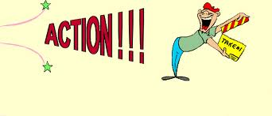
Plot
Plot is the sequence of events in a short story.
There are six parts of the plot.

Slide 3
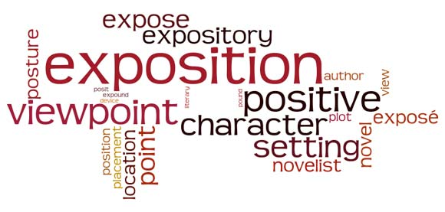
EXPOSITION
Provides important background information, often describing the setting and introducing the main characters.

Slide 4
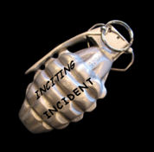
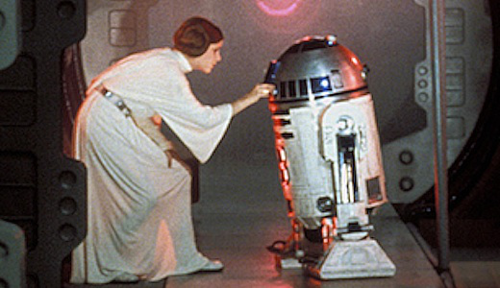
Inciting Incident
The event that creates the central conflict or struggle in the work.

Slide 5
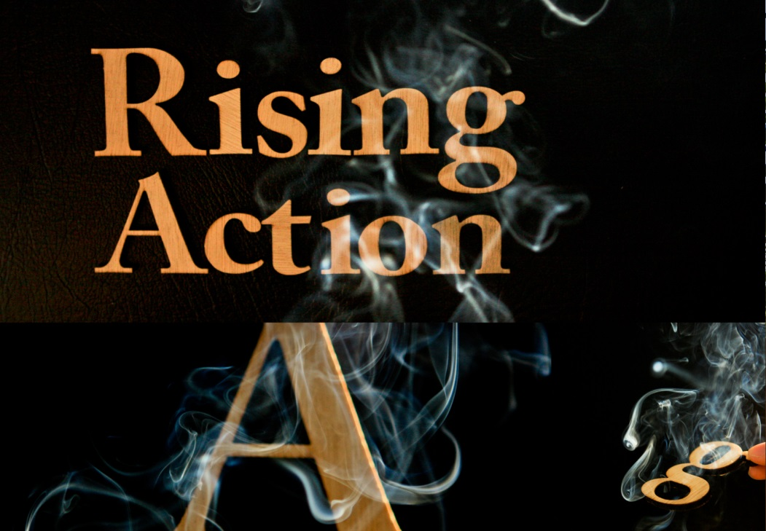
Rising Action
All events between the inciting incident and the climax; the development of the story.

Slide 6
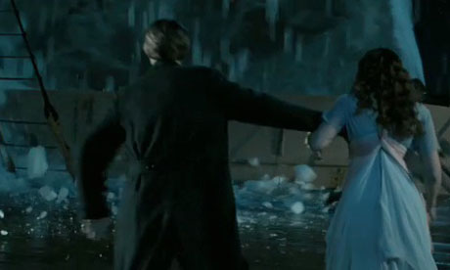
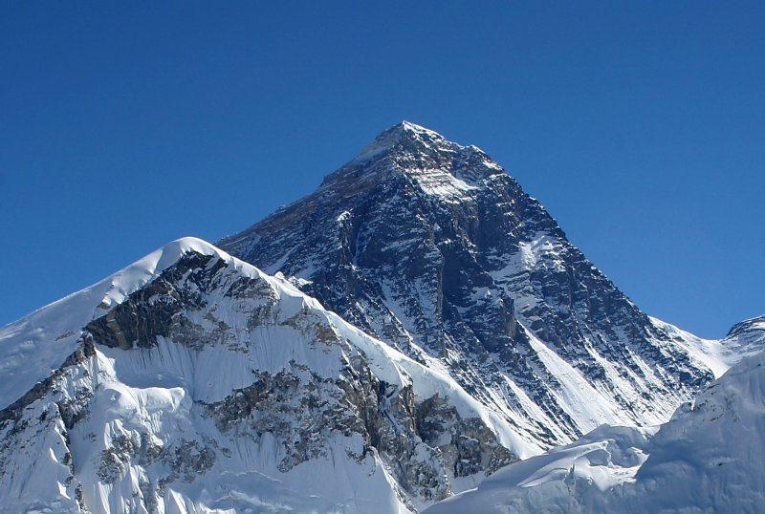
Climax
The high point of action and suspense in the story; the turning point in the story.

Slide 7
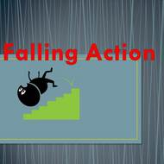
Falling Action
The part at which the conflict begins to move to a resolution.

Slide 8
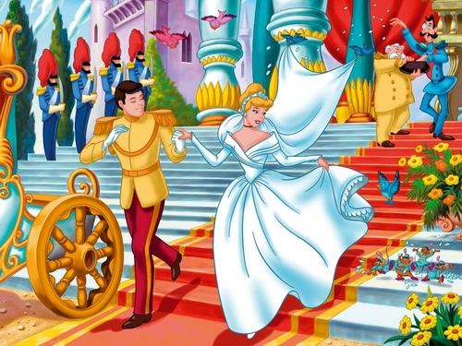
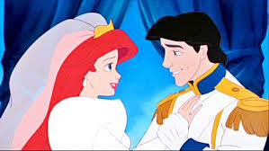
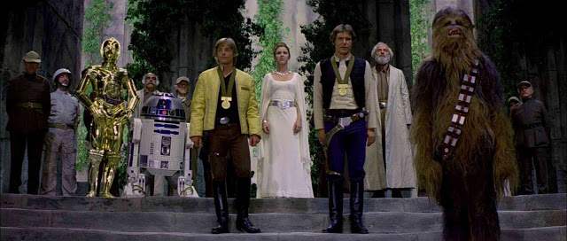
Resolution
The point at which the conflict is resolved.

Slide 9
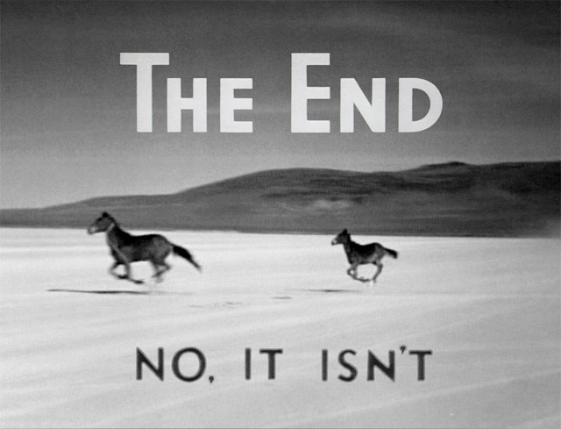
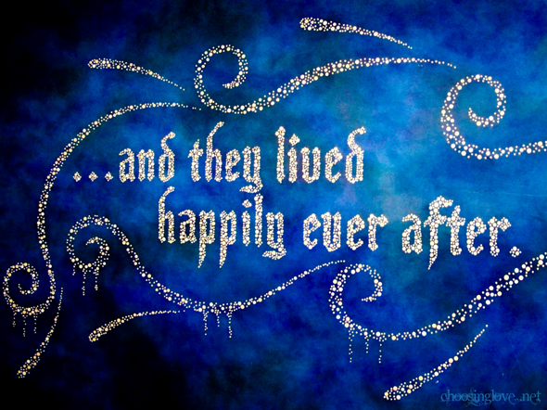
Dénouement
Anything that happens after the resolution of the plot (the tying up of loose ends).

Slide 10
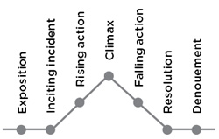
Freytag’s pyramid
A diagram representing the structure of a well-made play (and adapted to the plot structure of novels and short stories as well.

Slide 11
Sketch it yourself!
And let’s made a mnemonic to help you remember the parts of the plot.
E
I
R
C
F
R

Slide 12
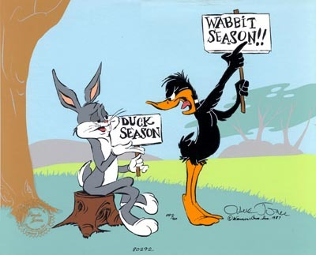
CHARACTERIZATION
Characterization is the process of developing or revealing the nature of a character.

Slide 13
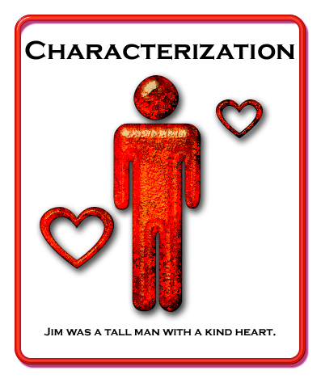
CHARACTERIZATION
Characterization may be revealed through description, what another character says about him, how the character behaves, or what he says.

Slide 14
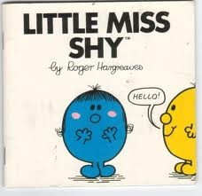
Direct Characterization
Characterization revealed by an author’s direct description.

Slide 15
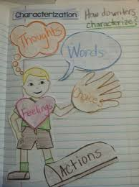
Indirect Characterization
Revealed by a character’s actions, words, or how others react or speak about him.

Slide 16
Characterization
Characters may differ based upon :
Appearance
Personality
Background
Motivation
Relationships
Conflict
Change

Slide 17
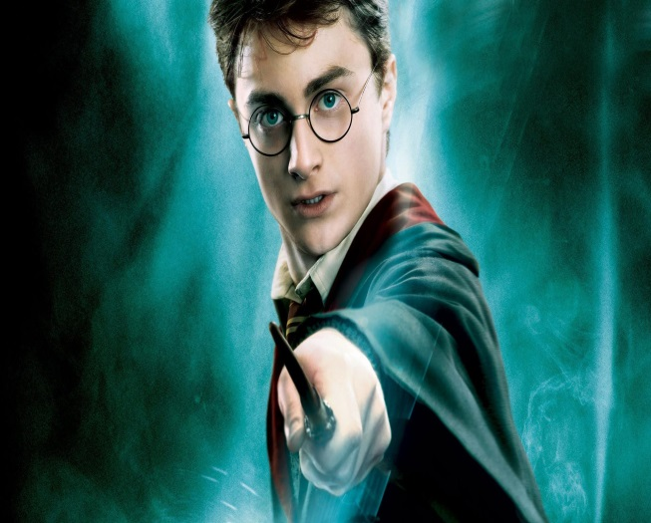
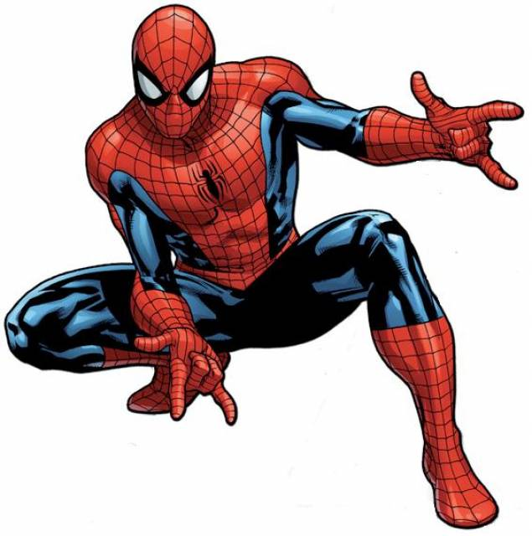
Protagonist
The main character of a story. When the protagonist is admirable, he is often referred to as a hero.

Slide 18
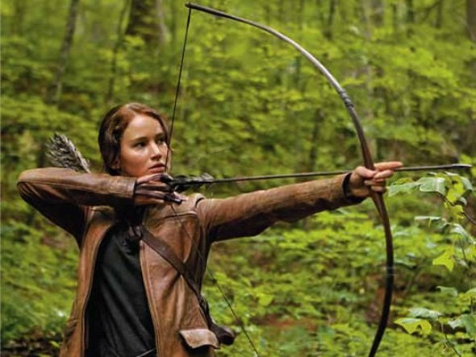
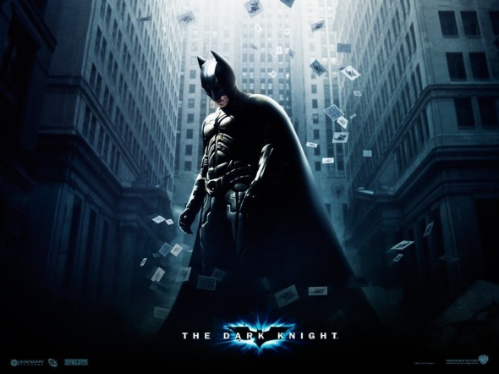
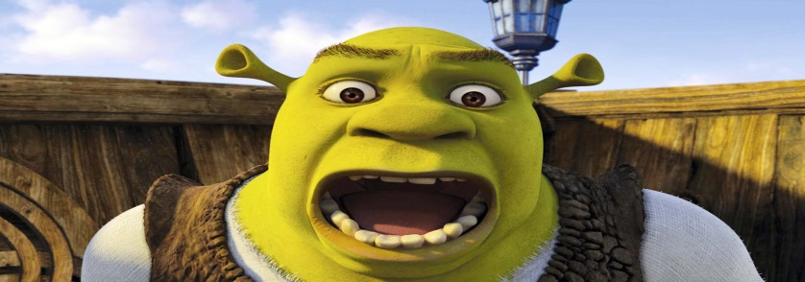
Protagonist
When the protagonist is an inept or otherwise ridiculous character who is presented sympathetically, he is referred to as the antihero of the story.

Slide 19
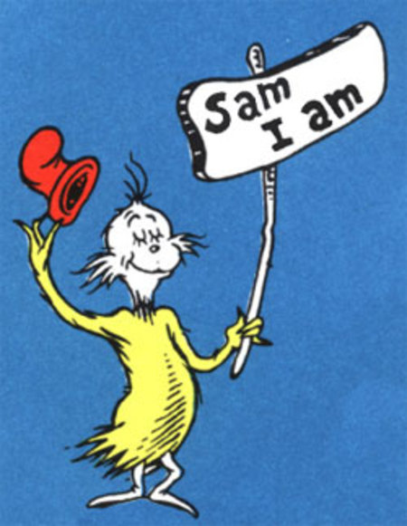
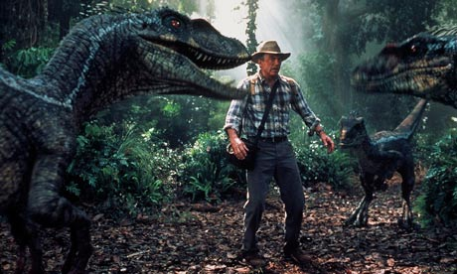
Antagonist
A major character pitted against the protagonist. The antagonist does NOT have to be evil; he is simply the character in conflict with the protagonist.

Slide 20
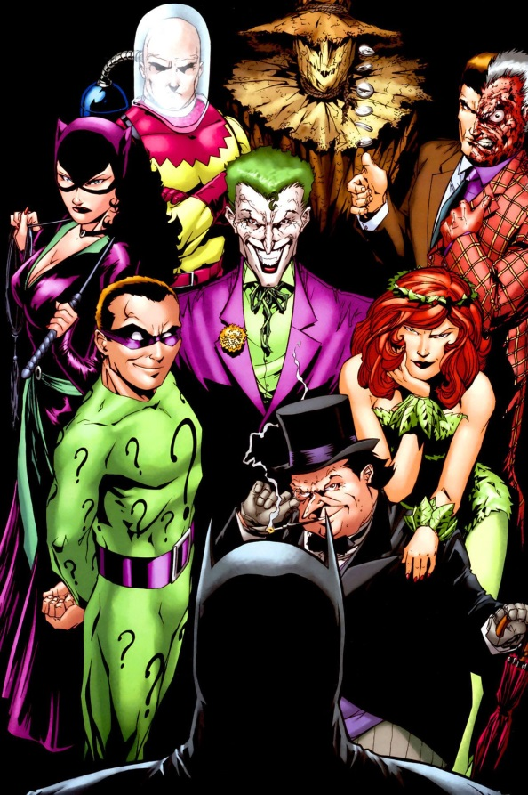
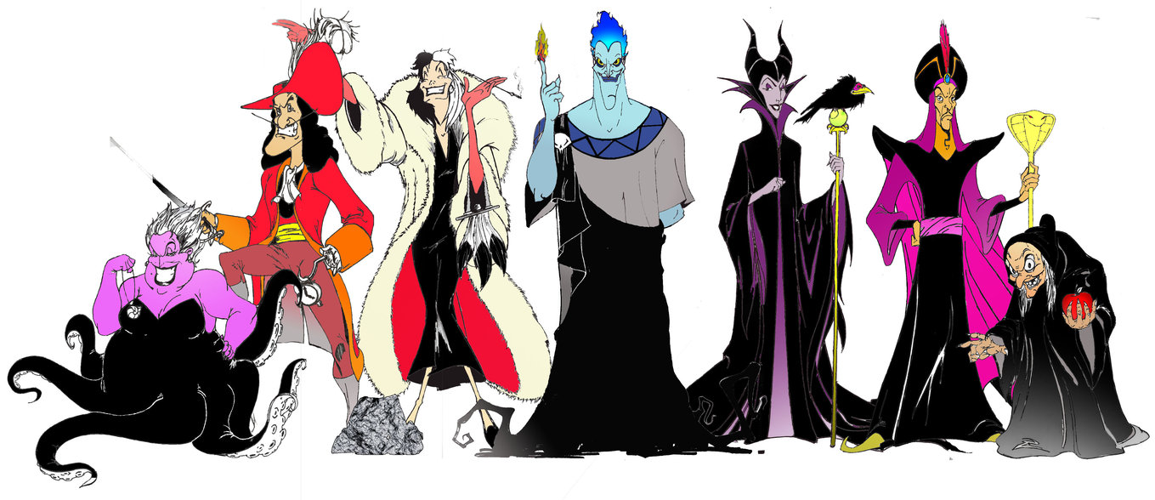
Antagonist
When the antagonist is a completely un-admirable figure, he is referred to as the villain.

Slide 21
FOIL
A character that contrasts with the protagonist in a way that illustrates or reveals one or more significant traits, attitudes or actions of the protagonist.

Slide 22
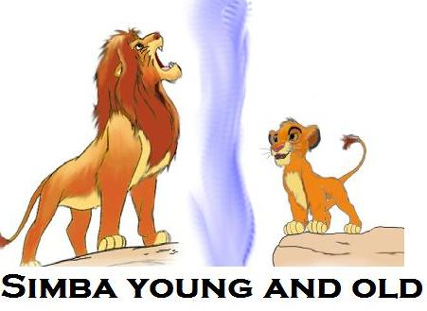
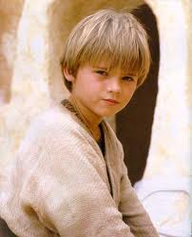
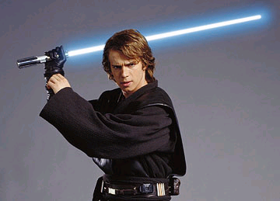
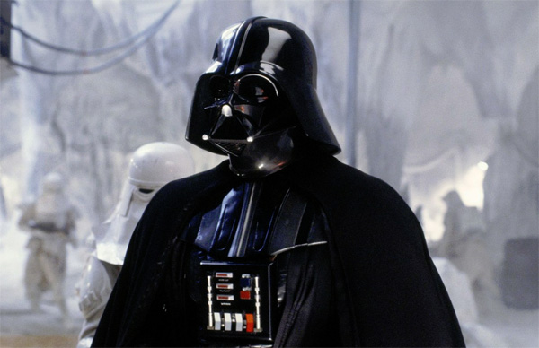
Dynamic Characters
Characters who change significantly during the course of a story.

Slide 23
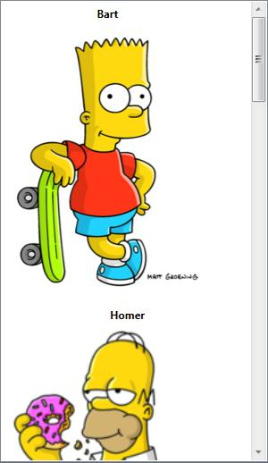
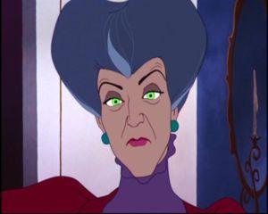
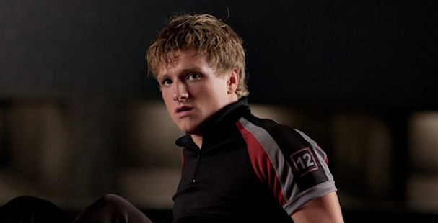
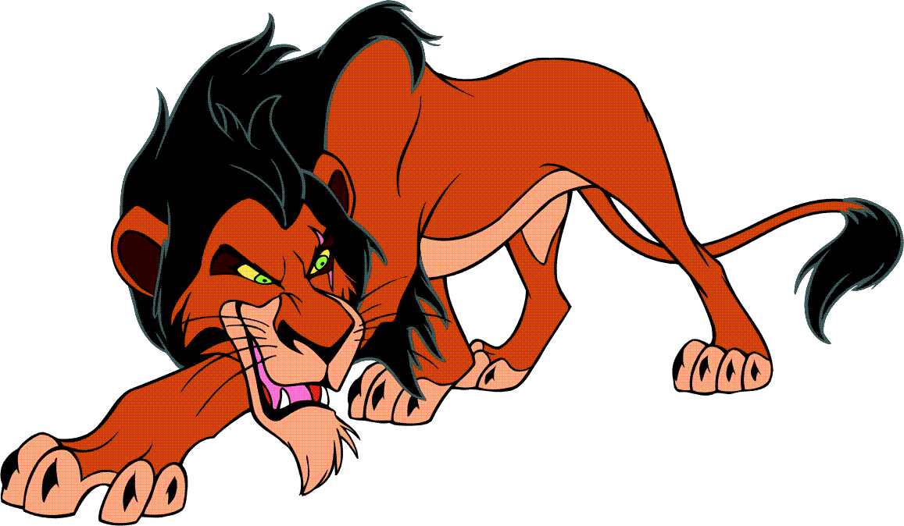
Static Characters
Characters who are unchanging throughout the story.

Slide 24
Flat Characters
Characters who are 1-dimensional; they only have a very obvious personality trait and are uncomplicated and do not change in the story (Primrose Everdeen).

Slide 25
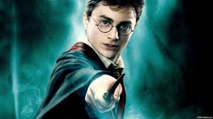
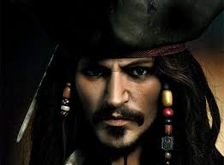
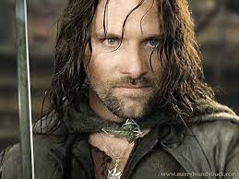
Round Characters
Characters who multi-faceted (like a diamond); they are complex, complicated, and more realistic with many personality traits, motivations, etc.

Slide 26
SETTING
The setting of the story is the time and place in which the action occurs.

Slide 27
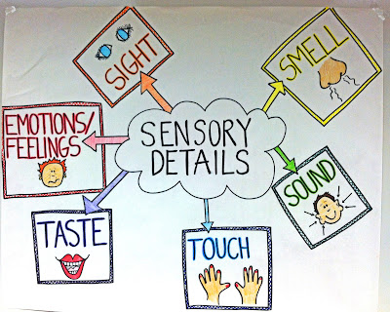
SETTING
To create setting, a writer uses specific details, including images of sight, sound, touch, taste, and smell.

Slide 28
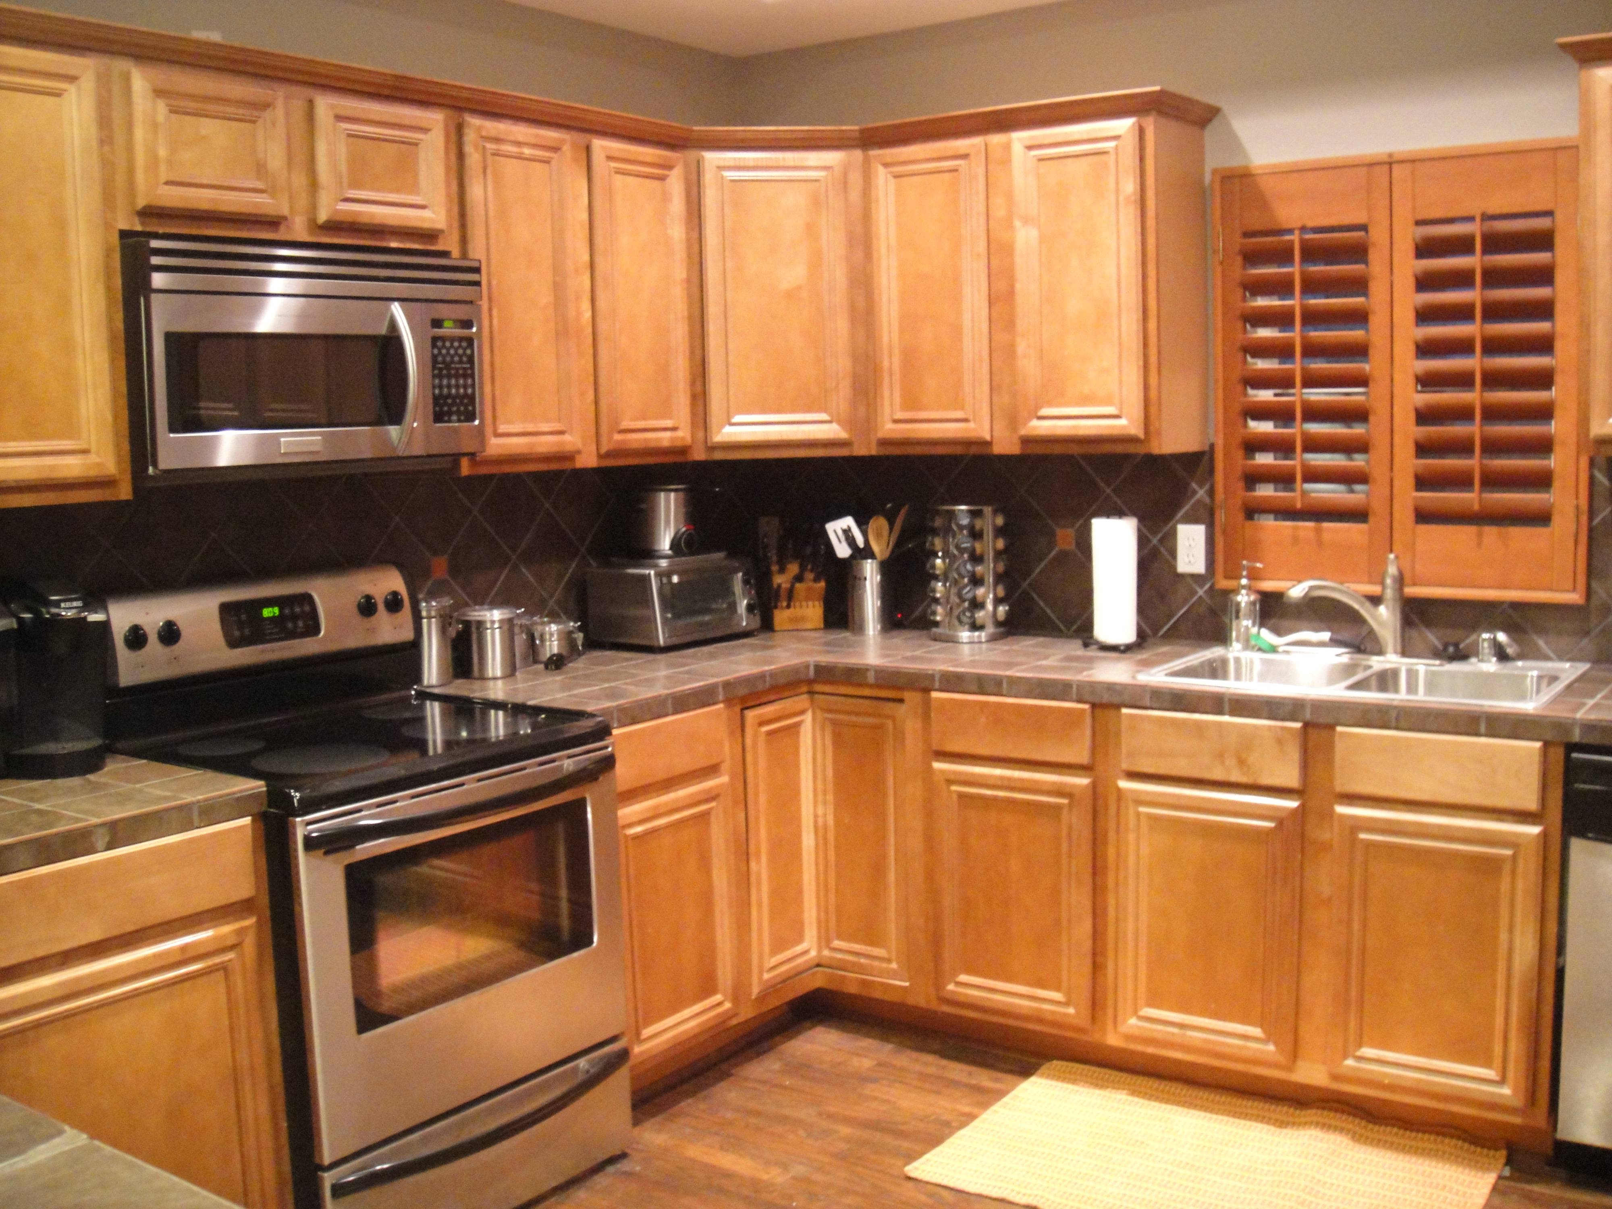
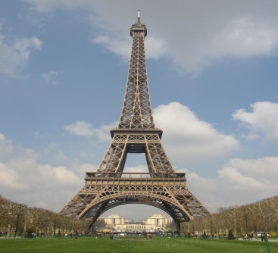
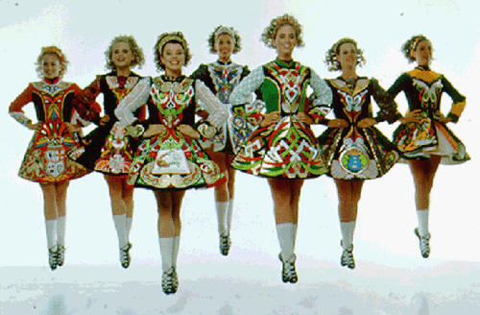
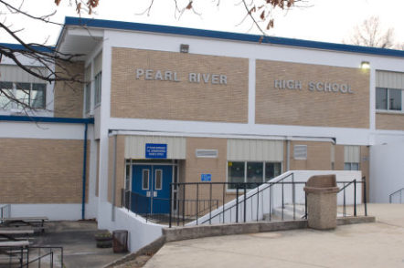
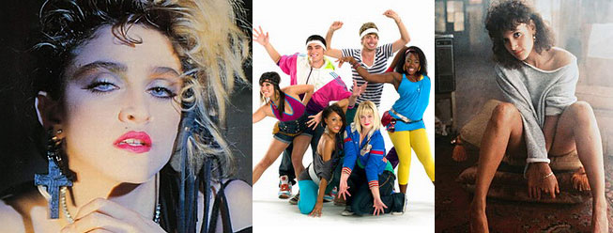
SETTING
Setting may be revealed by descriptions of scenery, weather, rooms, furniture, modes of transportation, clothing, customs, or dialects.

Slide 29
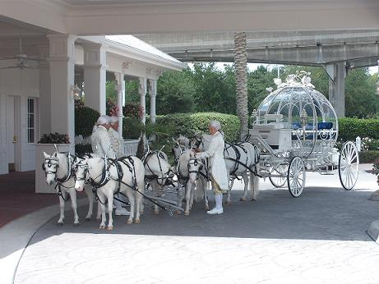
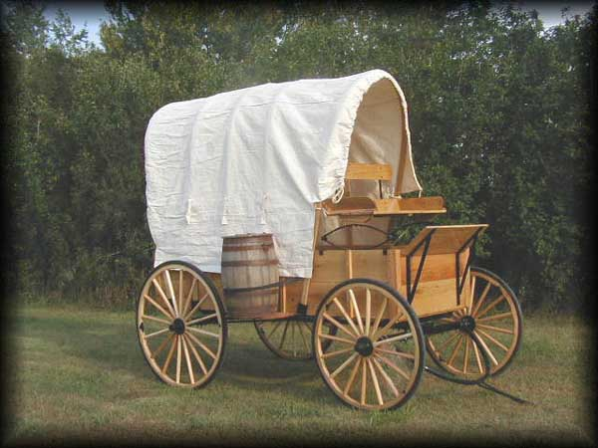
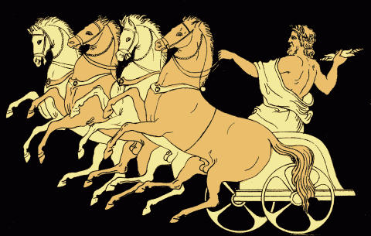
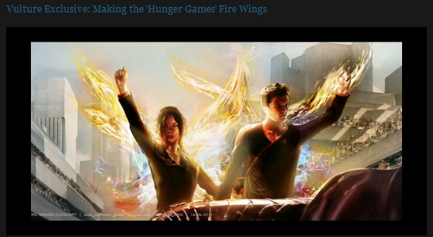
What is the setting?

Slide 30
Purposes & Uses of Setting
To make the action seem more realistic or believable.
To teach readers about a different way of life.
To create a mood.
To be the source of the central conflict.
To symbolize some concept that the writer wishes to emphasize.

Slide 31
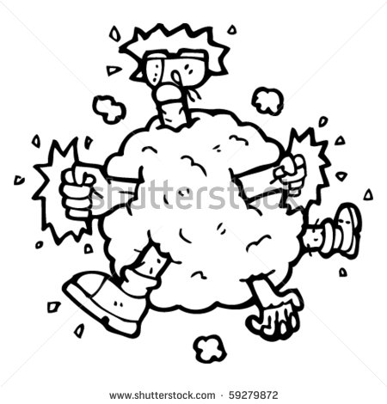
CONFLICT
The conflict is a struggle between two or more opposing forces in a literary work.

Slide 32
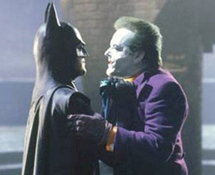
four types of conflict
Man vs Man: a type of external conflict where there is a struggle between two characters (the protagonist & the antagonist)

Slide 33
Man vs. Nature:
a type of external conflict when a character must overcome some natural obstacle or condition.

Slide 34
Man vs. Society:
a type of external conflict where a protagonist is in conflict with society or a value / condition in society.

Slide 35
Man vs. Self:
a type of internal conflict in which a character struggles within himself over a moral, intellectual, or emotional issue.

Slide 36
Point of View
The narration; is the act of telling a story. The speaker who tells the story is called the narrator.
The point of view is the vantage point from which a narrative (story) is told.

Slide 37
1st Person Point of View
The narrator is a character (someone in the story) who is telling the story. Uses 1st person pronouns (I, me, we, us)

Slide 38
2nd Person Point of View
The narrator is speaking directly to YOU, the reader. Uses 2nd person pronouns (you, your)

Slide 39
3rd Person Limited
The narrator is NOT a character in the story BUT uses the viewpoint of only one character. The narrator knows more about this character than the character may know about himself.

Slide 40
3rd Person Omniscient
The narrator knows all; his knowledge of all of the characters is unlimited.

Slide 41
Theme
The general idea about life that the author wants to communicate.

Slide 42
Theme
A theme is the central message of the story.
It provides an insight into life. The theme is the point or purpose as a whole.

Slide 43
Theme
The theme is expressed in a complete sentence.
For instance: a central concept in the story might be love.
The theme may be:
Love conquers all.;
Love is blind.; or
Love stinks!

Slide 44
Theme
The theme of the work is seldom stated directly; rather it is usually implicit (hinted at) in the story:

Slide 45
Theme
To find the theme, ask yourself:
? “What is the overall purpose or effect of the work?”
? What does the main character learn about life?”
? What is the author saying about life, humanity, or relationships?”

