Slide 1
English 9 Honors Cultural Literacy
Allusions to Know

Slide 2
Each slide will contain the following information:
The term / phrase
The type of allusion (mythological, historical, Biblical, literary, etc.)
The background or context of the term/ phrase.
The modern definition or usage of the term/ phrase.
An example (or two) of how the term/ phrase is used
You are responsible for all information on each slide.
Note # 1: the photos, cartoons, and clip art used for examples of each term are not meant to demonstrate any political, religious, or social biases or viewpoints. I have tried to find relevant examples in the media. This slideshow was created in the summer of 2016, preceding a very contentious election season and many of the political cartoons and memes reflect this.
Note # 2: titles of long works (e.g., novels) and foreign words & phrases (e.g., hakuna matata) are indicated by italicizing the word or phrase. When you handwrite these names, words, or phrases, you should underline them (hakuna matata). In these slides, they will be italicized.

Slide 3
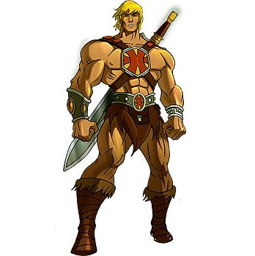
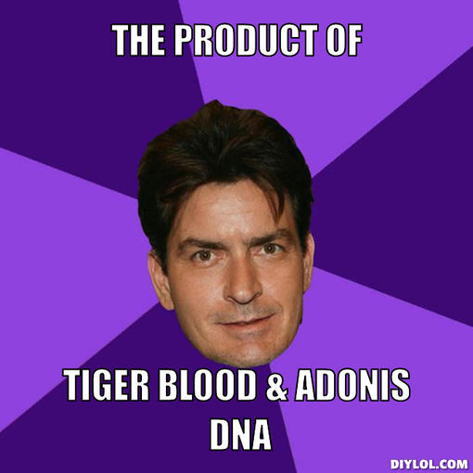
1. Adonis (Mythology and Legend)
Beautifully handsome, Aphrodite, goddess of love, fell in love with him. Being loved by a goddess was hazardous, however, and Adonis was killed while boar hunting (the boar was reputed to be the jealous war god Ares in disguise). In one version of the story, Zeus arranged for Adonis to spend part of the year with Aphrodite and part with Persephone, queen of the underworld, whose eye he had also caught. This custody arrangement explained the cycle of the seasons.
His name is now a metaphor for youthful male beauty.
Hollywood’s newest Adonis is constantly found in the company of throngs of women.

Slide 4
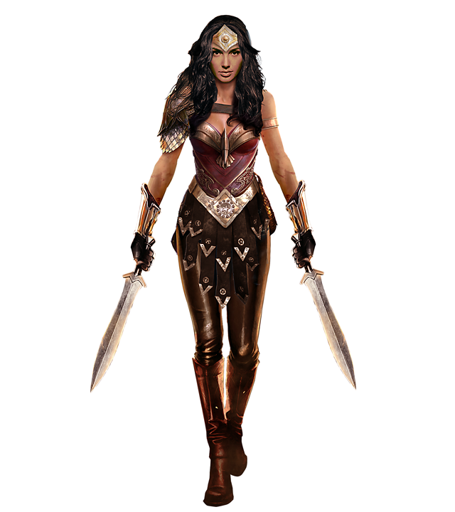
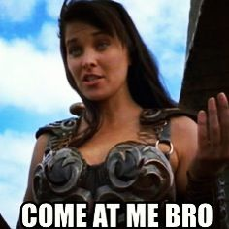
2. Amazon (mythology & legend)
According to Greek mythology, the Amazons were a tribe of warlike women living in Scythia, an area around the Black Sea. An Amazon unit fought in the Trojan war on the losing Trojan side; their leader was killed by Achilles (who regretted his action when reflecting on her beauty and prowess). One of the twelve labors of Hercules was to steal the girdle (belt) of the Amazon queen Hippolyta. The hero Theseus fought them and married one.
A woman warrior in Greek mythology. Also, a tall, strong, powerful, and aggressive woman, often one with masculine traits. The term is evolving into a compliment.
The Amazonian American Woman’s Olympic basketball team left their opponents in the dust.

Slide 5
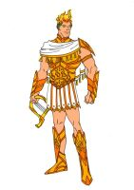
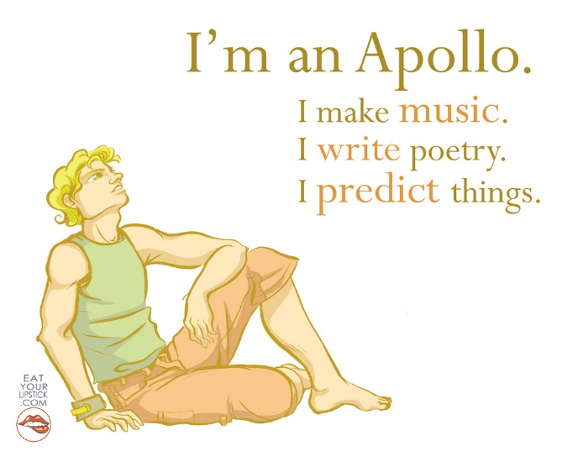
3. Apollonian (mythology & legend)
This term is derived from the Greek god Apollo, god of prophecy, light, medicine, and other positive, civilized, and constructive aspects of humanity.
Having the characteristics of, or pertaining to, the Greek god Apollo. These are such qualities as rationality, intellect, a spirit of justice, creativity. All in all, a cast of mind opposite to Dionysian, which is instinctive, irrational, uninhibited, destructive.
The political candidate won overwhelming support from his constituents primarily due to his Apollonian intelligence, fairness, and conduct.

Slide 6
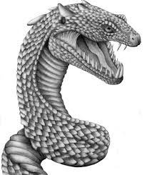
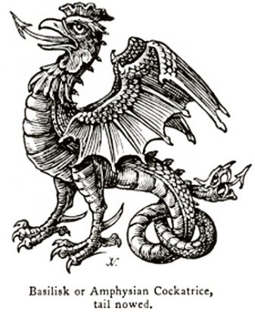
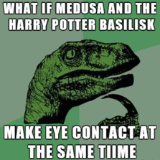
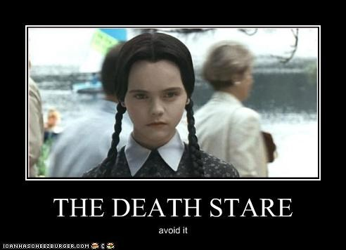
4. Basilisk (myth and legend)
A spellbinding, deadly creature. The word comes from the name of a mythical reptile purported to be the king of lizards. It was also called a cockatrice, and it was said to be hatched from the egg of a male chicken by a reptile. Its best-known qualities are the world’s worst case of bad breath and the ability to kill with a glance.
The word is frequently used in the phrase basilisk stare, the term for a look which is ferociously compelling, frightening, or seductive – or all of the above.
The teacher did not need to say a word; he gained control of the class with a quiet, but very effective, basilisk stare. The unruly 2nd graders quickly lapsed into a terrified silence.

Slide 7
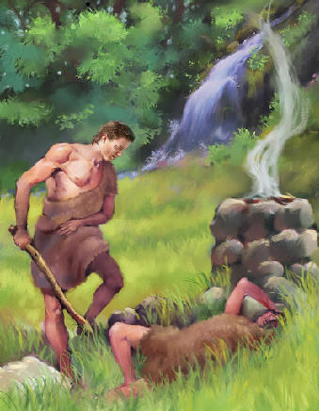
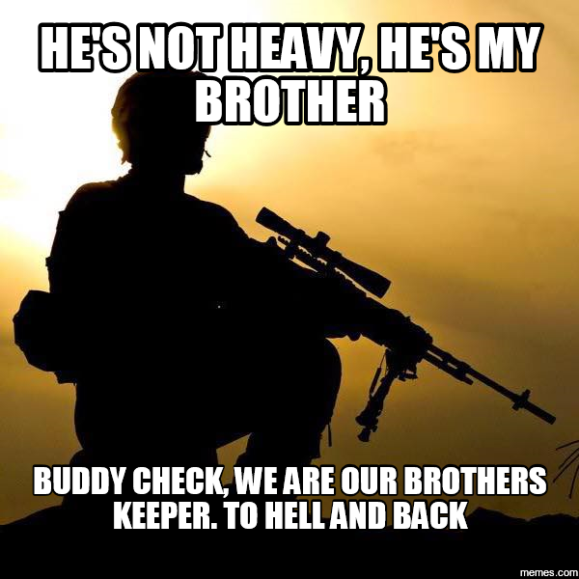
5. My brother’s keeper (the Bible)
Taken from Genesis, it is part of the evasive response by the guilty Cain, who has killed his brother Abel, to the question posed by God: “Where is Abel thy brother? And he said, I know not: am I my brother’s keeper?” Cain is cursed, always to be a fugitive and wanderer in the earth (mark of Cain).
The phrase is now most commonly used as a statement: yes, you are your brother’s keeper; you should feel responsibility for the well-being of your fellow man.
By risking public ridicule and even abuse, Atticus Finch proved that he is his brother’s keeper; Tom Robinson deserved a fair trial despite the racist views of the society.

Slide 8
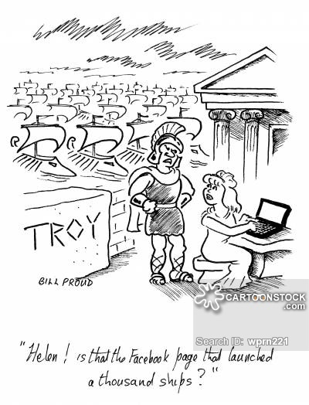
6. Face that Launched a Thousand Ships (mythology)
The reference is to Helen of Troy, said to have been the most beautiful woman in the world. She was married to Menelaus, the king of Sparta, but was abducted by (or eloped with) Paris, Prince of Troy, thus precipitating the Trojan War, according to legend and the Iliad. Other Greek heroes and city-states joined forces with Menelaus and Sparta to make war against Troy.
An extremely beautiful woman for whom, presumably, men would be willing to fight and die.
To Josh, Emily had the face that launched a thousand ships, and he was willing to leave the carnival grounds rather than have to watch her marry Pete.
(can you name that story? ☺ )

Slide 9
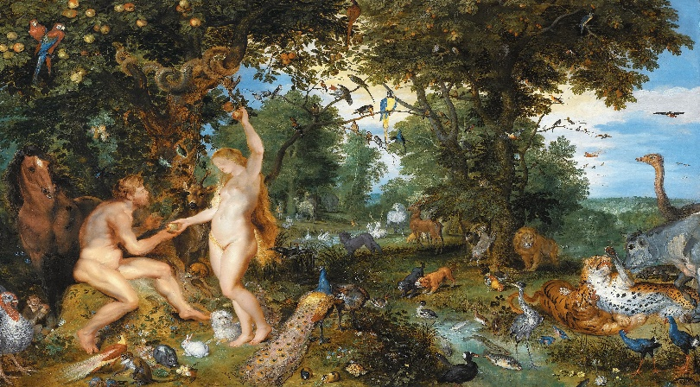
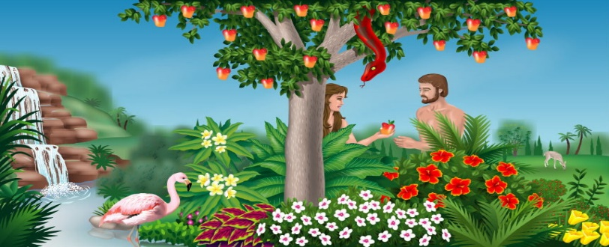
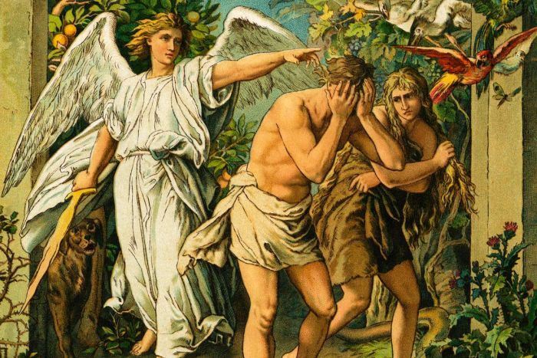
7. Eden (the Bible)
In Genesis, the Garden of Eden was the first home of Adam and Eve, whence they were expelled when they had sinned. When they were evicted, however, Eden was not destroyed, and much interest, research, and legend have been devoted to finding it.
It is also referenced as Paradise Lost; one has the perfect life or situation and then destroys it due to character flaws (hmmm...sounds like Greek tragedy, no?)
Paradise; an unspoiled, idyllic, peaceful place
Many celebrities lose their idyllic life in Eden when they succumb to the temptations of drugs, alcohol, or other vices.
Paradise Lost

Slide 10
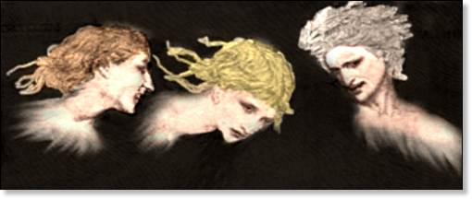
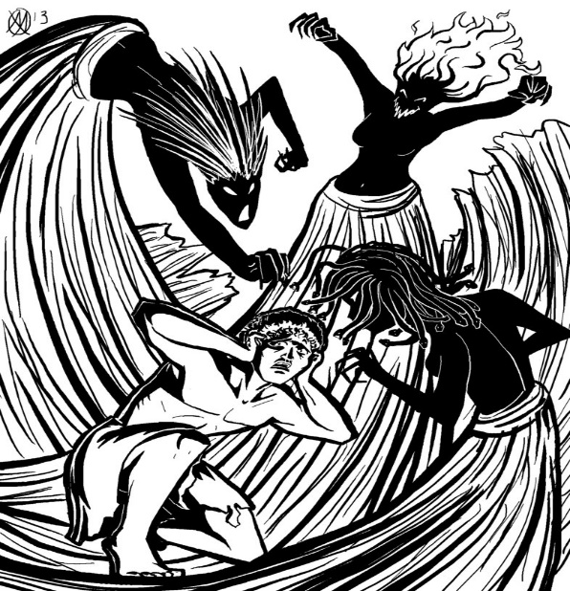
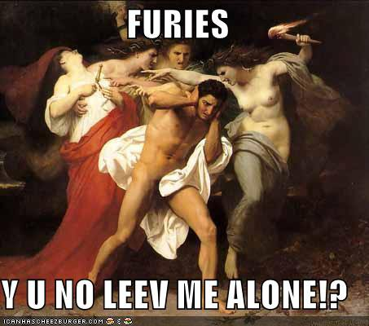
8. Furies (mythology and legend)
The term is often applied to cruelly vengeful females, as well as to the mental and emotional tortures of the guilt-ridden – as in “pursued by the Furies” – when it is really the conscience doing the pursuing. In Greek and Roman mythology they were three goddesses, Tisiphone (the Avenger of Blood); Alecto (the Implacable); and Megaera (the Jealous One). They continued to pursue transgressors even beyond death.
They were so feared that the Greeks did not refer to them by their real names, but rather as “the kindly ones.”
Merciless, relentless avengers; an frightening agent of punishment.
When their cheating on the test was discovered, the teacher’s wrath was that of the Furies unbound.

Slide 11
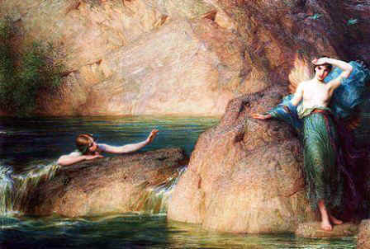
9. Halcyon Days (mythology and legend)
Halcyon is the Greek name for the bird we know as the kingfisher. The ancient Greeks believed the bird nested at sea at the winter solstice and calmed the waves while is incubated its eggs. This halcyon period lasted fourteen days.
In Greek mythology, Halcyon was the daughter of Aeolus, god of the winds. She was married to a mortal who died at sea, and threw herself into the ocean to be near him. The gods changed them both into kingfishers.
Calm, peaceful days, a happy golden period; prosperous, affluent times.
Upon the final defeat of the evil wizard Sauron and the destruction of the Ring of Power, mankind finally entered halcyon days.

Slide 12
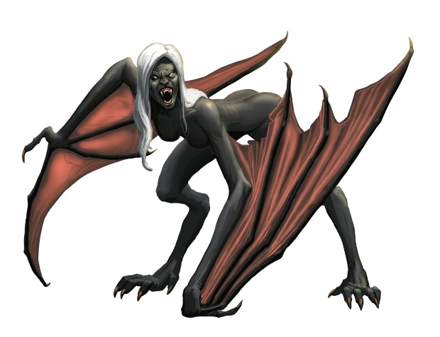
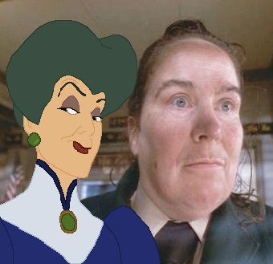
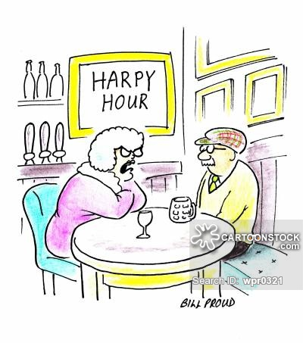
10. Harpies (mythology and legend)
A foul, malign creature in Greek mythology that is part woman (head) and part bird (body). Greek legend has it that harpies snatched food from the blind king Phineus until they were frightened away by the Argonauts, the heroes who sailed with Jason to recover the Golden Fleece.
A grasping, unpleasant woman. A predatory person, leech; or a shrewish woman. She is a woman who destroys someone (usually a man) completely.
Agatha Trunchbull was a malicious harpy, making poor Matilda’s life miserable.

Slide 13
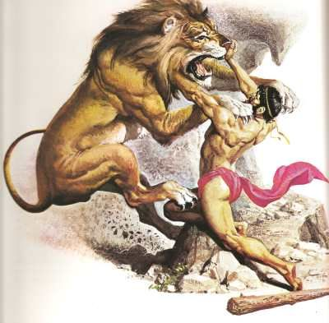
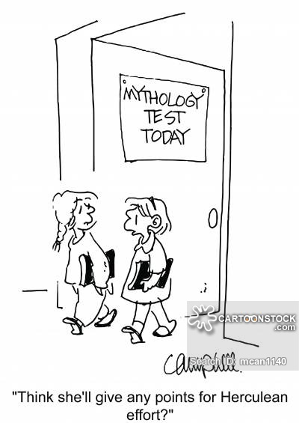
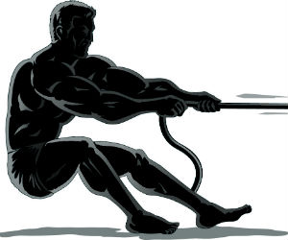
11. Herculean (mythology & legend)
From the name of the mythic Greek strongman Hercules. The meaning comes from the tales of his adventures and his twelve labors, which were very difficult indeed. Hercules is the Latin form of his name, Heracles the Greek form.
Hercules was the son of Zeus and mortal Alcmena, who caught his eye while her husband was away. She gave birth to twins – Hercules, the son of Zeus, and Iphicles, the son of her husband. Hercules showed his heroic stuff even as an infant when he strangled in his crib two snakes that Zeus’s jealous wife Hera had sent to kill him. He is, of course, most famous for his twelve labors including killing the Hydra, cleansing the Augean Stables and capturing Cerberus.
Of, relating to, or characteristic of Hercules; or (often not capitalized) of extraordinary power, extent, intensity, or difficulty.
To meet the Herculean demands for food production, more than 1,100 workers will staff the kitchen and dining tent.
Olympic athletes put forth herculean effort to qualify for the honor of competing in the games.

Slide 14
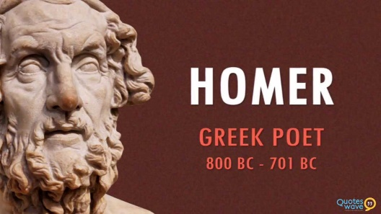
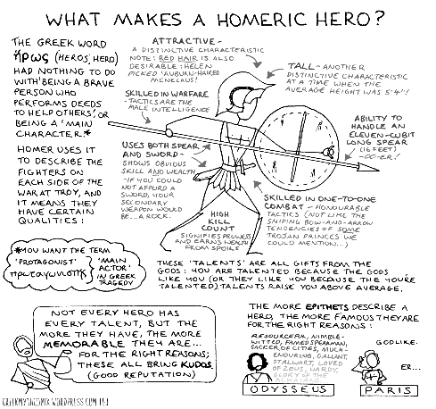
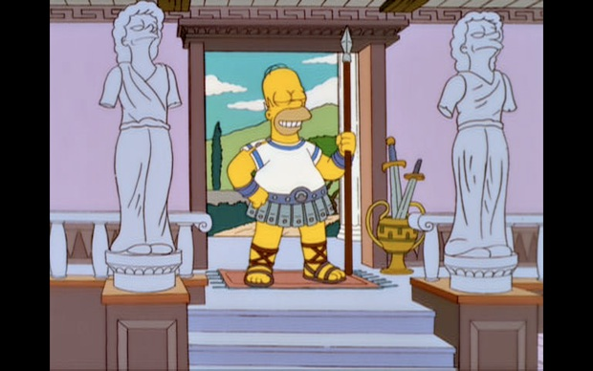
12. Homeric (literature)
From the name of Homer, the ancient Greek bard commonly accepted as author of the Iliad and the Odyssey, epic poems relating the stories of gods and heroes in the Trojan War and in the adventures of Odysseus.
Little is known of the real Homer – not even whether he actually lived, or if so, when. According to legend, he was blind. The poems are among the Western world’s greatest literary works.
Today’s definition means: Of, relating to, or characteristic of the Greek poet Homer, his age, or his writing. Also, of epic proportions. Larger-than-life; mythic.
Griffey’s was the third of a Homeric trio which gave the Mariners a team-record 183 home runs in the 1996 season and helped Seattle pound New York 10-3 at Yankee Stadium on August 17th.

Slide 15
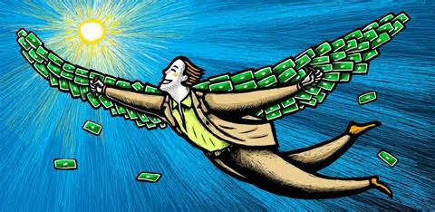
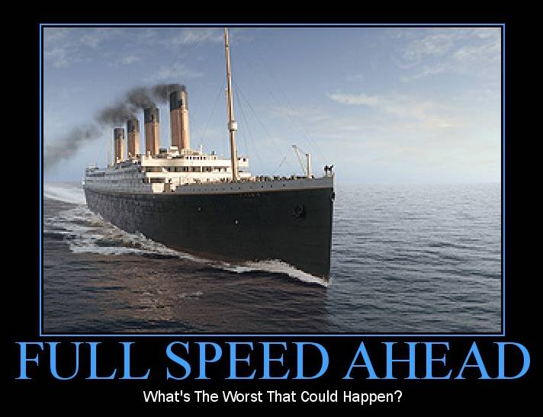
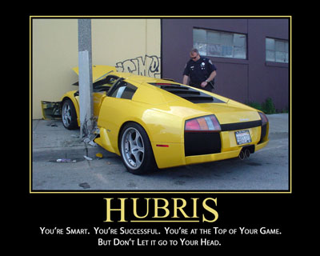
13. Hubris (language & litrature)
In Greek tragedy, hubris is a prideful refusal to accept the authority of the gods. When the central character begins to believe that his achievements result from his own powers and virtue rather than from the favor of the gods, he is guaranteed to be laid low.
Exaggerated pride or self-confidence. This is the pride that goes before a fall, an excessive, overreaching, arrogant pride.
Fans enjoy observing the wanton hubris of each contestant announce to three judges and the entire country that he will be the next American Idol.

Slide 16
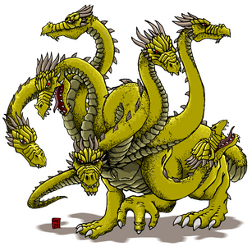
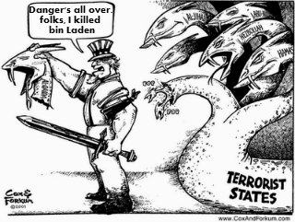
14. Hydra-headed (mythology)
Having many heads. The Hydra was a monstrous serpent in Greek myth. The creature was killed by Hercules – it was one of his twelve Herculean labors. When he chopped off a head, two more grew back. Hercules succeeded by having his charioteer apply fire to each wound to prevent the regrowth.
The expression is applied figuratively to situations in which problems repeat themselves, or appear at many points.
The Egyptian onion is a curiosity. From a single bulb it sends up half a dozen stout, hollow stalks each of which sprouts a bulb cluster; in no time, you have a hydra-headed monster ready to take over your whole garden.

Slide 17
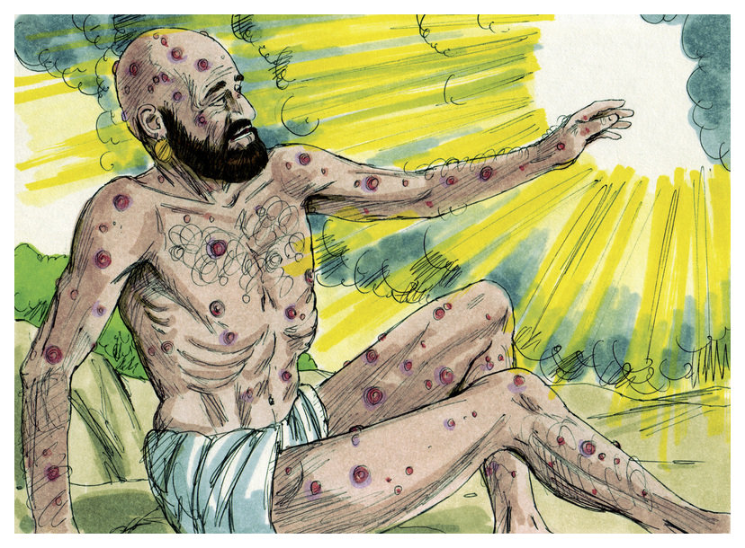
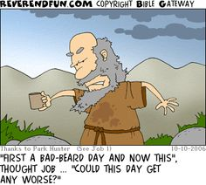
15. Job (the Bible)
The hero of the Old Testament book of Job who endures afflictions with fortitude and faith. His story is the exploration of why, if suffering is punishment for sin, do the good suffer?
At the outset, Job is a wealthy man when God permits Satan to test Job’s faith. Job’s wealth disappears, his children die, he is afflicted with boils, but his faith never wavers, and eventually he is rewarded.
Now his name is used to allude to someone who suffers a succession of woes. As an adjective, describing cumulative misfortune, the word is Jobian. Usually a generally good, ordinary person who is suffering a string of bad misfortunes – one bad thing happening after another.
On her first day of school, Scout felt much like Job; she had gotten in trouble with the teacher twice, had been embarrassed in front of her peers, and had been spanked by Calpurnia. That’s a lot to happen in one day to such a young kid!

Slide 18
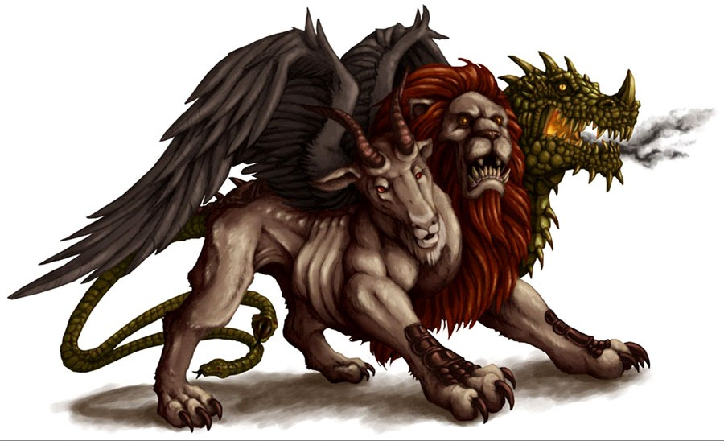
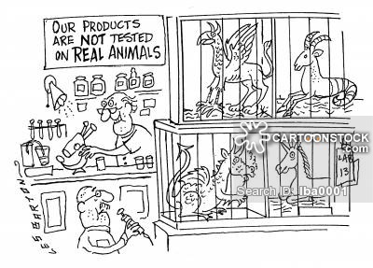
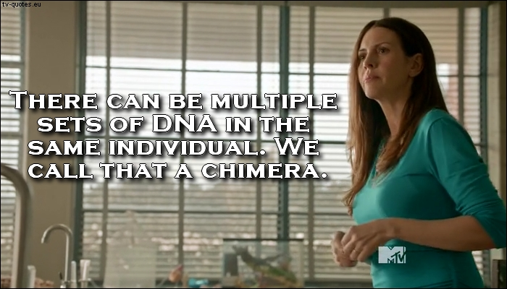
16. chimera (myth & legend)
In Greek mythology, the chimera was a monster: the front third was a lion, the midsection a goat, the rear end a serpent. Luckily it was slain by the legendary hero Bellerophon, riding the winged horse Pegasus.
Bellerophon would be shocked to learn that research into animal cloning has now created sheep/goat and sheep/cow combinations and they are called chimeras.
An imaginary monster compounded of incongruous parts; an illusion or fabrication of the mind. Something that is fantastically visionary, improbable, or the product or an unchecked imagination is called chimerical.
The English 9H students’ proposal for no homework on weekends is, unfortunately, nothing but a chimera. Sorry, scholars.

Slide 19
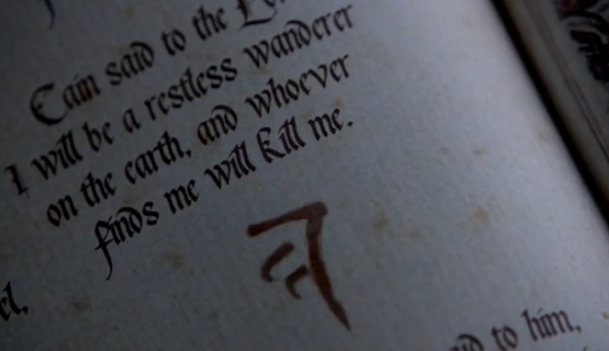
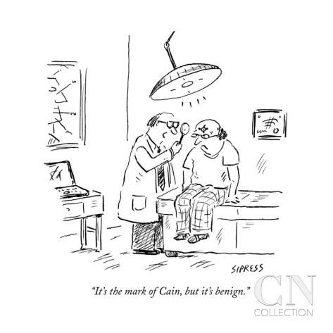
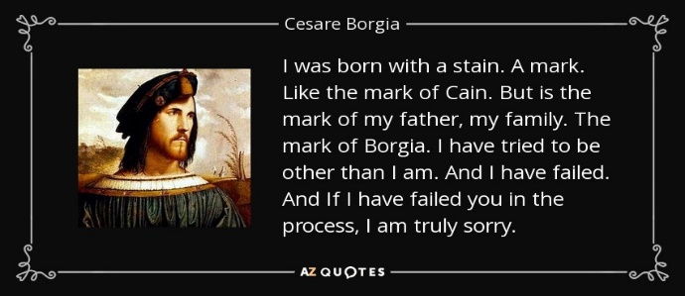
17. Mark of Cain (the Bible)
In Genesis of the Bible, Cain, first child of Adam and Eve, murdered his younger brother, Abel, and became an exile and a fugitive.
As the Bible tells the story, when the Lord asks the guilty Cain about his brother, Cain responds, “’I know not; Am I my brother’s keeper?’ And He said, ‘what hast thou done? The voice of thy brother’s blood crieth unto me from the ground.’” The Lord put a mark upon Cain so that he would be identified as the killer of his brother but would also be protected in his wanderings. As the term is used today, the idea of a protective mark has been lost; only the negative sense of a mark or shame or criminality remains.
A stigma; the distinguishing mark or brand of a criminal or outcast.
While O.J. Simpson was found not guilty of killing his wife and her friend, he will forever bear the mark of Cain in the eyes of the media and the public.

Slide 20
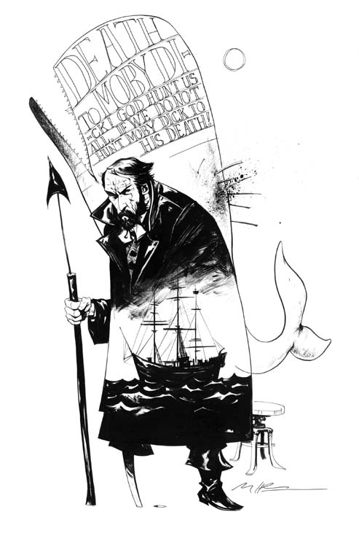
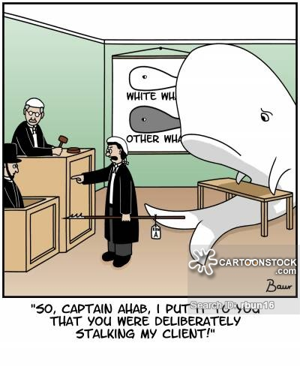
18. Ahab (literature)
As King Ahab’s story is told in the Old Testament (Kings), he married Jezebel, a foreigner, who introduced the worship of pagan gods. His cruel and wicked deeds (usually at the request of his wife) brought down the wrath of God on himself and Jezebel.
Melville’s Ahab is the Captain of the whaler Pequod and is obsessed with Mody Dick, the mysterious, monstrous white whale that had crippled him years before. The pursuit of vengeance consumes Ahab and eventually all of his crew. Only the narrator Ishmael, who had stood apart from the madness of the rest, survives. Ahab, caught in the rope of the harpoon he has stuck into the whale, continues his pursuit even in death.
Both allusions identify Ahab with someone who has a fanatical, monomaniacal pursuit of a goal. A “white whale” is the obsessive object of pursuit.
Fox Mulder (The X-Files) is the new-age Ahab; his white whale being proof of extra-terrestrial life.

Slide 21
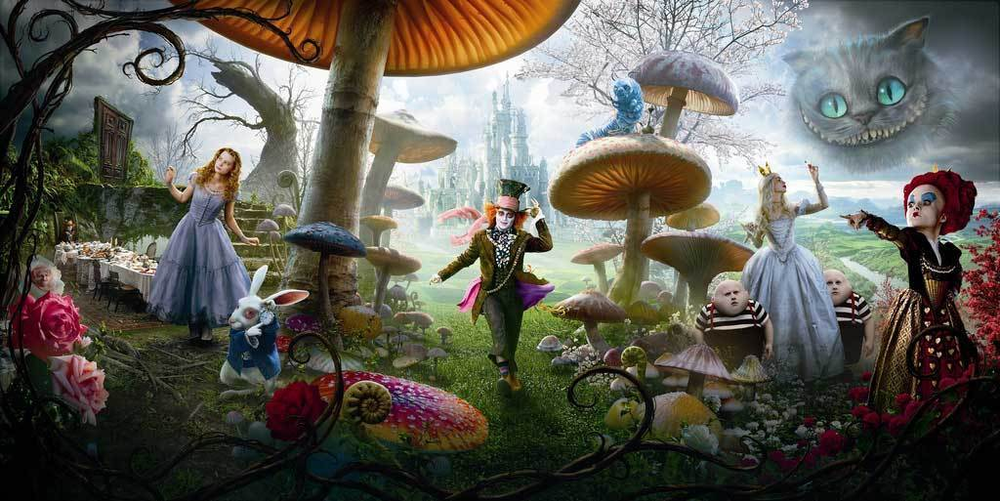
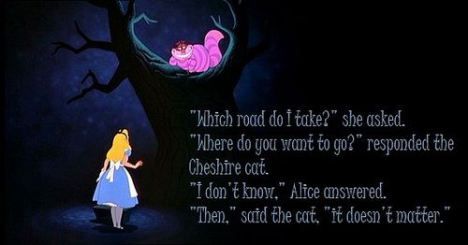
19. Alice in Wonderland (literature)
This phrase is from Lewis Carroll’s 1895 classic Alice’s Adventures in Wonderland. Little Alice follows a rabbit down a hole and finds herself in a strange country populated by a collection of human and animal characters who act with insane illogic.
This famous character in literature whose name is evoked to describe surreal situations in which people and behavior are comically strange, whimsical, contradictory, and bizarre.
Upon entering college, many students feel like Alice down the rabbit hole when suddenly confronted with such a vast diversity of individuals with equally different backgrounds, cultures, personalities, and interests.

Slide 22
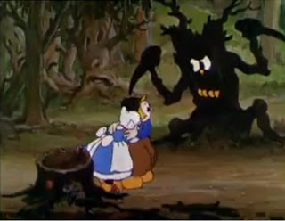
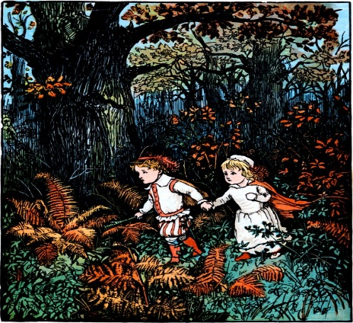
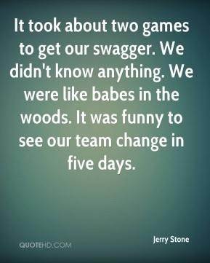
20. Babes in the woods (literature & legend)
The expression comes from an English play and ballad in the early 17th century, The Children in the Wood. The story was about two children whose father left them in the care of his wife’s brother. The uncle would inherit a fortune if the children died, so he hired two men to murder them. One of the thugs could not bring himself to do the deed and murdered his partner instead. He then left the children alone in a wood where, helpless, they died.
Naïve, trusting folks; neophytes.
Many young people flock to LA and NYC from small towns in search of fame and celebrity; unfortunately, however, many of these babes in the woods succumb to the darker forces of urban life.

Slide 23
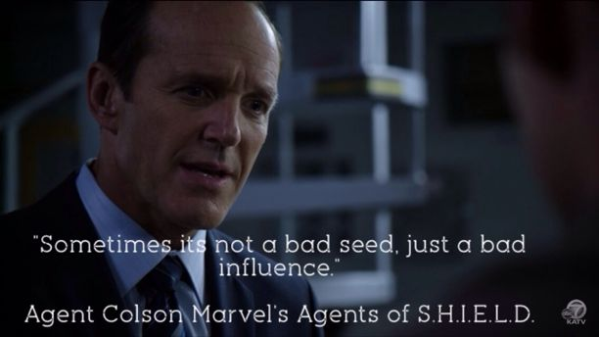
21. Bad seed (literature)
The term comes from the 1955 play The Bad Seed by Maxwell Anderson (based on a novel by William March), about a little girl who is a calculating murderess.
An evil person whose wickedness is innate and evident from birth (he/she is born evil).
While he is obviously influenced by an equally evil father, one assumes that Draco Malfoy is simply a bad seed who needed little help nurturing his naturally wicked, cruel and greedy personality.

Slide 24
22. Bermuda Triangle (history, culture, ideas)
In fact and legend, the Bermuda Triangle (or Devil’s Triangle) is an area of the North Atlantic between Bermuda, Florida, and Puerto Rico, where the disappearance of numerous ships, airplanes and people is often blamed on mysterious forces. The “lost squadron,” six U.S. Navy planes lost on a training mission on December 5, 1945, is but one example. Storms are common in the region, but scientific explanations have produced no other specific phenomena which would make so many things disappear seemingly without a trace. Explanations have also included space aliens and the lost city of Atlantis.
A black hole or area/ location where things inexplicably vanish.
Jean’s locker was the local Bermuda Triangle; homework simply vanished without a trace.

Slide 25
23. Caesar’s wife (history)
Julius Caesar divorced his wife Pompeia because of an episode in which a man had been admitted illicitly and without Pompeia’s knowledge to Caesar’s house during a women-only religious rite. The man was tried for sacrilege, and even though neither Caesar nor his wife knew anything of the crime, he divorced his wife. When asked why, he responded that Caesar’s wife should not be subject even to suspicion of wrongdoing.
A person above reproach and free from any semblance of wrongdoing.
During a political campaign, if either candidate is anything less than Caesar’s wife, he can bet that his opponent will use it against him.

Slide 26
24. Cheshire cat (literature)
A broadly grinning cat in Lewis Carroll’s Alice’s Adventures in Wonderland (1865). The Cheshire cat could appear and disappear, and its pronouncements were enigmatic, or at least ambiguous. The cat sometimes leaves only its grin behind.
The origins of the phrase go back further than that, but no one is certain of the source, although theories abound. One is that cheese from the English county of Cheshire were molded in the shape of a cat or were stamped with a grinning cat. Others say that an inept sign painter in Cheshire made all of his lions look like cats.
To look like a Cheshire cat (or to grin like one) is to grin broadly.
Vapid, conceited, and having no ability other than to smile brightly, Gilderoy Lockhart is the Cheshire cat of Hogwarts.

Slide 27
25. doppelgänger (myth & legend)
A ghostly counterpart of a living person; a double or alter ego. A doppelganger often represents the evil or unpleasant aspect of a person’s nature. From the German words “doppel,” meaning “double,” and “ganger” meaning “walker”
A double or look-alike. When used as an archetype in literature, it means a character’s alter-ego.
Anakin Skywalker succumbs to the dark side of the force and to his doppelganger, Darth Vader, by the end of Episode III.

Slide 28
26. Down the rabbit hole (literature)
The phrase is the heading of Chapter One of Alice’s Adventures in Wonderland, the 1865 classic of Lewis Carroll. Alice’s adventures begin when she follows the White Rabbit down a large rabbit hole, “never once considering how in the world she was to get out again.”
Into a bizarre, surreal or strange situation, episode or series of events; going on a bizarre adventure.
Upon entering college, many students feel like Alice down the rabbit hole when suddenly confronted with such a vast diversity of individuals with equally different backgrounds, cultures, personalities, and interests.

Slide 29
27. Elysian Fields (mythology)
In ancient Greek and Roman mythology, Elysium (Greek, meaning “happy, delightful”) was the place where heroes and those blessed by the gods went after death. According to Homer, Elysium lay “at the world’s end,” where life was always comfortable, where temperate breezes wafted through the gardens and groves and the cares of ordinary earthly existence never intruded.
The landscape of paradise; an abode of delight, an idyllic place.
Yearly rainfall at Brookfield Park ranges from less than 3 inches to as many as 21. Within a single season, the wombat’s habitat can careen from billiard-table-bare soil and rock to waving elysian fields of grass.

Slide 30
28. Et tu, Brute (history; literature)
Words of Julius Caesar when he recognized his friend Marcus Junius Brutus among his assassins. A reproach for an act of treachery or betrayal by a friend or ally. It’s Latin and means “And you too, Brutus?” This phrase is best known from Shakespeare’s Julius Caesar, but is quoted by the Roman historian Suetonius in The Lives of the Caesars.
Words to identify a betrayal: The phrase often shows up as “Et tu, ____?” with the name of the betrayer in the blank. A Brutus is someone trusted who betrays you.
Et tu, Severus?
Readers could almost hear that question on Dumbledore’s lips as Snape advanced on him in the climax of Harry Potter and the Half-Blood Prince.

Slide 31
29. Everyman (literature)
The term comes from one of the Morality Plays of the 15th century, allegorical dramas that served as popular entertainment and provided religious and ethical instruction to the unlettered public. Everyman, the central character, is, of course, the ordinary person. Other allegorical characters represent virtues, vices, and good and bad influences.
In the play, Everyman receives a summons from Death and calls on his friends – Beauty, Fellowship, Kindred, and Worldly Goods, among others – to accompany him. Only Good Deeds agrees to attend Everyman to the grave.
The typical or ordinary person. John Q. Public, the man in the street, not rich or brilliant or exceptional – just one of us.
The allure of reality television is watching how the Everyman can be turned into an overnight celebrity.

Slide 32
30. Fall on One’s Sword (language & idioms)
From the Roman custom of committing suicide by falling on one’s sword when one failed in a big way. Frequently the fallers were generals or high officials who felt honor-bound to take their lives if they were responsible for a defeat in a battle or failed conspiracy. Brutus comitted this act when defeated by Octavian and Mark Antony at the battle of Philippi in 42 A.D.
Sacrifice oneself. Voluntarily take full responsibility – and voluntarily pay the price – for a disastrous turn of events. For example, to acknowledge a grave error by resigning from office.
When the teacher announced he was aware of the cheating that had taken place, Daryl decided he needed to fall on his sword, admit to his deceit, and ask for forgiveness.

Slide 33
31. Frankenstein (literature)
Victor Frankenstein is the central figure of the gothic novel Frankenstein (1818), by Mary Shelley. He constructs a being of parts of dead bodies and succeeds in bringing it to life. But Frankenstein’s monster is rejected by humans, including its creator, and becomes vengeful. Ultimately it kills Frankenstein’s wife and brother, and Frankenstein himself dies in attempting to destroy it.
The story has been told numerous times in wildly and wildly varying film versions, so that the tale is well known even though few read the novel. Shelley’s powerful themes – the dangers of unbridled and reckless technology, and the responsibility of scientists for their work – reverberate with the public more than ever as our dependence on, and vulnerability to, new and complex technologies grows.
One who creates, and is ultimately destroyed by, a technological marvel, scientific advance, or something else destructive that cannot be controlled. In common use, the creation is often substituted for the creator, so that the word also can refer to a monstrous creation or a work that ruins its originator. The uncontrollable outcome is commonly referred to as a “Frankenstein’s monster.”
Many feel that cloning is a Frankenstein’s monster which will have irreparably sinister consequences.

Slide 34
32. The Hatfields & the McCoys (history, culture, ideas)
Families in the Appalachian Mountains of Kentucky and West Virginia engaged in a long and bitter feud. Now synonymous with two bitterly opposing groups, those engaged in a seemingly irreconcilable feud. The Hatfields and the McCoys were the real thing, and in the last twenty years of the 19th century their battles attracted national attention. These two families were neighbors of course. The origins of the feud seem to be obscure, but the story does have its Romeo and Juliet: there evidently was a romance between Rose Anna McCoy and Johnson Hatfield in 1880 which the McCoys broke up.
The quarrel got out of hand in 1882 when Ellison Hatfield was shot. This event set off a spiral of revenge. Things began to quiet down after 1888, although there continued to be occasional outbreaks of violence.
The reference refers to participants in a seemingly endless argument; two parties of deep animosity and hatred or strong rivalry.
The Little Brown Jug game epitomizes Rockland’s own version of the Hatfields and the McCoys with the feud being fought on the football field rather than on farmland.

Slide 35
33. Hemlock (history, culture, ideas)
A poisonous preparation made from the hemlock plant and drunk as a way of committing suicide.
That’s how death came to the Greek philosopher Socrates. In 399 B.C., he was tried and sentenced to death on charges of corrupting the morals of youth and committing religious heresies. Resisting all efforts to save his life, he willingly drank the cup of hemlock poison given him. His life and death were recorded by his most famous student, Plato.
The term is typically used in the phrase “drink hemlock,” and the phrase more widely describes an act that is deliberately self-destructive. “Hemlock” is something dangerous and lethal.
Many students argue they would rather drink hemlock than complete any summer reading.
The team decided it would rather drink hemlock than face the opposing team’s opening lineup.

Slide 36
34. Sherlock Holmes (literature)
A fictional character created in 1887 by Sir Arthur Conan Doyle who became the prototype for the modern mastermind detective. The brilliant English detective’s adventures were recounted in a series of stories beginning with A Study in Scarlet. Doyle not only created the eccentric, arrogant protagonist but Holmes’s loyal friend and biographer, Dr. John H. Watson, and his archenemy, the equally brilliant and supremely evil Dr. Moriarty.
Holmes’s greatest qualities were his powers of observation and deduction and his knowledge of arcane science, but he was prone to boredom and was a cocaine addict. The character was hugely popular, and has remained so ever since, in Doyle’s books and in films and plays in countries and languages around the world.
To be a Sherlock Holmes is to display the superior observational and analytic powers of the Doyle character. A Sherlock Holmes may also describe the solution to a knotty problem as “elementary,” his most characteristic utterance.
Modern-day forensic science combines Sherlock Holmes-style sleuthing with high-tech gadgets. It is only elementary that so many crimes are solved today!

Slide 37
35. Jekyll & Hyde (literature)
The names are drawn from the most famous literary rendering of such a dual personality, Robert Louis Stevenson’s 1886 novel, The Strange Case of Dr. Jekyll and Mr. Hyde.
The virtuous Dr. Jekyll is fascinated by the idea of good and evil and develops a drug which transforms him into the terrifying Mr. Hyde, a distillation of the evil latent in his nature. Jekyll also has an antidote which allows him to restore himself, but the evil side gradually takes over and the antidote proves useless.
One having a two-sided personality, one side of which is good and the other evil; the good and evil sides of an individual, and, by extension, of a group, an organization, or a class. It is also used to describe someone who has sudden mood swings.
Stress is a powerful force, capable of transforming the most mild of Jekyll-like students into the most monstrous of Hydes during AP week.

Slide 38
36. kill / shoot the messenger (language & idioms )
While the messenger is not the cause of the bad tidings, he or she is the one within reach. The phrase has been offered by the news media as an explanation for public hostility to them; the media merely report bad news, but the public blames them for it.
The concept comes from Sophocles, the Greek tragic poet who wrote in Antigone, “None love the messenger who brings bad tidings.”
To punish the bearer of bad news, even though the person has done no more than deliver the information. Usually expressed in the phrase, “Don’t kill the messenger” when someone is about to deliver unfortunate news.
The teacher begged the students not to kill the messenger as she relayed the new school rules forbidding children from talking in the hallways during the change of classes.

Slide 39
37. Lemmings (history, culture, ideas)
A small, short, chubby, furry, and bobtailed rodent indigenous to cold regions of the Northern Hemisphere. The little creatures are famous for mass migrations when excess population drives them to search for food. Once moving, lemmings always travel in a straight line regardless of obstacles, including lakes and rivers, and vast numbers of them die.
To be a lemming is to mindlessly follow the crowd, often to destruction; to mindlessly go along with the group.
Many stock market investors react to market conditions like lemmings – stampeding up the mountain when markets are rising and down into the cold sea when they are falling.

Slide 40
38. Stealing Someone’s Thunder (language & idioms)
In the 17th century, playwright John Dennis invented the sound effect of rattling a sheet of tin to mimic thunder. He used this effect in his own denounced play – but his sound effect was widely copied. Frustrated, Dennis proclaimed that his rivals would not accept his play but were happy to “steal my thunder.”
To “steal someone’s thunder” is either to take credit for the idea of another or to lessen the effect of another’s idea (or announcement) by suggesting the same idea first.
After Jeffrey proposed his money-saving idea to his boss, he was astonished that the boss stole his thunder and presented the idea to the board as if the boss had thought of it himself.
The principal was anxious to see the gleeful reaction when she announced the pay raise to the teachers the next day, but her thunder was stolen when news of the raise appeared in the morning paper.

Slide 41
39. Nemesis (language & idioms)
Nemesis was the Greek goddess of vengeance & retribution. She punished people for wrongdoing, especially for excessive pride (hubris).
A person’s “nemesis’ is that which causes his or her downfall, or the person can refer to the downfall itself.
A cyclist considered that particular stretch of mountain to be his nemesis, costing him a racing victory year after year.
When the new student stood up to the school bully who had everyone else terrified, the word spread quickly that the bully had finally met his nemesis.

Slide 42
40. Pyrrhic Victory (history, culture, ideas)
Pyrrhus was a general in ancient Greece. After defeating the Romans in battle in which he suffered great losses, Pyrrhus told those who wanted to congratulate him on his victory, “Such another victory and we are all ruined.
A “Pyrrhic victory” is one in which the winner’s victory comes at such a great expense that it is scarcely better than losing.
Yes, he finally made it to the top of the company, but it was a Pyrrhic victory. His total focus on the job over the past years had led to the end of his marriage, alienated many of his friends, and caused several stress-related health problems.
The homecoming win was a Pyrrhic victory because several key players were injured and will probably be out for the rest of the season.

Slide 43
41. Handwriting on the Wall (The Bible)
According to the Book of Daniel, Belshazzar, the King of Babylon, gave a great banquet, at which the guests praised the gods of silver, gold, bronze, wood, iron, and stone. Suddenly, a human hand appeared and wrote mysterious words on the wall. Daniel translated the writing, saying it prophesized that Belshazzar’s reign was over. That night, the king was killed.
The phrase “handwriting on the wall” refers to an indication that doom or misfortune is coming.
I took my boss’s suggestion that I might want to start updating my resume to be the handwriting on the wall; I knew it wouldn’t be long until my job, like many others in our company, would be cut.
I was completely shocked when my boyfriend broke up with me, but my friends said I should have seen the writing on the wall when he kept “forgetting” to call me and began to spend all of his free time with his friends.

Slide 44
42. Albatross Around One’s Neck(literature)
In Samuel Taylor Coleridge’s poem, “The Rime of the Ancient Mariner,” a sailor shoots an albatross, a bird considered to be a good omen. As punishment, the sailor is forced to wear the carcass of the albatross around his neck.
An “albatross around a person’s neck” is a burdensome, ongoing problem.
Although we have an outstanding basketball team, our biggest rival continues to be the albatross around our necks. We haven’t won a game against them in over three years.
Although credit cards are convenient, the temptation to overspend can be great, and before you know it, you can have an albatross around your neck with debt that is seemingly impossible to pay off.

Slide 45
43. Don Quixote / Quixotic/ tilting at windmills (literature)
Don Quixote is a romance written in the 1600s by Miguel de Cervantes. (aka: Man from La Mancha) The hero, Don Quixote, loses his wits from reading too many romances, and he sets off on his own knightly adventures, accompanied by his sidekick, Sancho Panza. The two have various comic adventures. In one of the most famous, Don Quixote attacks a group of windmills, believing them to be giants. (This is referred to as “tilting at windmills”.
To be a “Don Quixote” or to be quixotic is to be foolishly or impractically idealistic. “Tilting at windmills” refers to a naïve attempt to be heroic.
Fresh out of law school, I believe I could single-handedly right all the wrongs in our criminal justice system. I finally realized I was being quixotic.
In our two party democratic system, independent candidates are often considered to be tilting at windmills when they try to challenge the solidly entrenched Republicans and Democrats.

Slide 46
44. Bedlam (language & idioms)
“Bedlam” was a popular nickname for London’s Hospital of St. Mary of Bethlehem, a mental hospital founded in the 14th century. Because the patients were simply housed there with little treatment, they tended to wander the halls talking to themselves or screaming and fighting with each other.
“Bedlam” has come to mean wildly chaotic or extremely raucous and noisy.
It is bedlam in the halls after the final bell rings on the last day of school before summer vacation.
My parents came home expecting to find bedlam after they left us alone for the weekend, but they were surprised to find the house even neater and cleaner than it was before they left town.

Slide 47
45. Sour Grapes (literature)
In “The Fox & the Grapes”, a fable by Aesop, a fox tries over and over again to reach some grapes dangling from a vine above him. He finally gives up and mutters that the grapes were probably sour anyway, so they would not be worth having.
“Sour grapes” refers to the attitude of a person who has been disappointed or thwarted. The person bitterly rationalizes that what he or she had wanted was probably not so great after all.
After losing the race for class president, Robert said he was glad he didn’t win because the job would have taken up too much of his time, but I think that was just sour grapes.
Karen displayed a major case of sour grapes when she was grounded and thus could not go on our long-awaited camping trip. She kept telling us that all we had to look forward to was insects & miserable weather and that she was relieved not to be going.

Slide 48
46. Benedict Arnold (history)
A military leader during the American Revolution, Benedict Arnold served with distinction, but alter became traitorous. Needing money & resenting the promotions of others, Arnold agreed to surrender a key fort to the British in exchange for a British military commission and a monetary payment. When an envoy carrying messages between Arnold and the British was captures, Arnold’s plot was revealed. He escaped and lived the rest of his life in Britain
A “Benedict Arnold” is a traitor.
My sisters called me Benedict Arnold when I decided to attend college at the biggest rival of the college they and my parents had attended.
Some people seem unable to see the difference between honestly questioning an action taken by the government and being a virtual Benedict Arnold.

Slide 49
47. Murphy’s Law (culture)
This saying, originally in the 1940’s (perhaps with the armed forces in WW II) , is as follows: “If anything can go wrong, it will.” An addition to this law is “and usually at the worst times.”
People often cite “Murphy’s Law” when something goes wrong and there is a sense of inevitability about it. It has come to mean bad luck.
After five beautiful, sunny days in a row, of course Murphy’s Law kicked in the day of the picnic and we were forced to cancel it because of thunderstorms.
When I said I wanted everything to be perfect for our surprise anniversary party for our parents, my sister, the pessimist, replied, “Remember Murphy’s Law.”

Slide 50
48. Scapegoat (the Bible)
According to the Book of Leviticus, each year on the Day of Atonement, a priest would symbolically place the sins of the Israelites on a goat, and then send it out into the wilderness, taking the sins of the people with it.
A scapegoat is a person who is blamed or punished for someone else’s misdeeds. At times an entire group or face can be a scapegoat, such as the Jews during the Holocaust.
In Fahrenheit 451, when the police fail to capture Montag, they turn their attention to the pursuit of an innocent man, making him the scapegoat for Montag’s illegal possession of books.
The assistant coach became the scapegoat for the team’s poor performance, losing his position even though he really had very little to do with the team’s losing record.

Slide 51
49. Tantalus (mythology)
In Greek mythology, Tantalus was a king who offended the gods and was condemned to suffer eternal hunger and thirst in Hades. He stood in water up to his chin, but when he bent to drink, the waters receded. Beautiful, ripe fruit hung overhead, but each time he reached for a piece, the wind blew the boughs out of his reach.
To be “tantalized” or to be like Tantalus is to be offered something desirable which is then withheld.
After being nominated for an Emmy Award numerous times and always seeing the award presented to someone else, the actress began to feel like Tantalus.
The poor peasants were tantalized by the aromas drifting down the street from the palace banquet.

Slide 52
50. The Emperor’s New Clothes (literature)
In Hans Christian Andersen’s story, an emperor hires two tailors, who promise to make him a beautiful new set of clothes that are unique in that they are invisible to a person who is stupid or unfit for office. When the two swindlers “show” the emperor the new clothes, he pretends to admire them, fearing he will be revealed to be unfit for office. The emperor “wears” his new clothes in a grand parade for the whole town, and no one will admit they cannot see the “clothes.” Finally, a small child shouts out the truth that the emperor is, in fact, naked.
The phrase “Emperor’s New Clothes” is often used in the context of someone, like the small child, pointing out the falseness or pretentiousness of something, especially when others are afraid to admit the truth.
It seemed that everyone was raving about the supposedly “brilliant” film that was nearly impossible to understand until finally one critic declared that all the admiration for such a pretentious, pointless movie was a case of the Emperor’s New Clothes.
When we first met Peter, he impressed us with stories of his travels around the world & his acquaintance with several famous people. We later realized that the emperor had no clothes; Peter had never been more than a hundred miles from his hometown and had never met a celebrity in his life.

Slide 53
51. Ivory Tower (language & idioms)
A French poet, Alfred deVigny, was said to have shut himself in an ivory tower so that he could compose his poems. Furthermore, “ivory towers” are mentioned in various 18th century fairy tales. The term thus refers to a beautiful, unreachable place. It has come to have negative connotations of being out of touch with reality.
A person who is secluded or protected from the real world and thus out of touch with reality is said to be residing in an ivory tower.
The engineers feared that the leaders of the company, sitting in their ivory tower, did not understand why the people in the field needed increased resources to ensure the new bridge truly would be safe.
In his ivory tower, the chancellor was unaware of the growing political protests occurring on the college campus. He still believed fraternity house pranks were the most serious problem facing the university.

Slide 54
52. Let the Cat Out of the Bag Buy a Pig in a Poke (language & idioms)
In medieval times, farmers often took piglets to market in a bag known as a “poke.” Sometimes an unscrupulous farmer would place a cat in the bag instead of a pig. If the cat managed to escape out from the bag, the farmer’s secret would be revealed to the buyer. Often buyers would not look in the bag to be sure they were not being swindled; they would simply pay for the pig in a poke.
We use the saying “letting the cat out of the bag” to refer to a secret’s being revealed. The phrase “buying a pig in a poke” describes something sight unseen. Buying a pig in a poke is considered unwise because of the risks involved.
George & Carla had kept their engagement secret for several weeks, but as soon as Carla showed up at the party wearing a new diamond ring on her left hand, the cat was out of the bag.
Since the political candidate had absolutely no previous experience in government, the voters were wary about voting for her; they then discover that they had elected an incompetent leader.

Slide 55
53. Bread & Circuses (history/ culture/ ideas)
The phrase was used by a writer during the time of the Roman Empire. He deplored the fact that the Imperial government was able to keep the populace content merely by distributing free food and providing entertaining spectacles, such as the fights in the Colosseum between people or between people & animals. The writer declared that it was shameful that people could be so easily kept in line by receiving “bread & circuses” from the government.
The term refers to policies designed to prevent unrest by keeping people happy and thus deflecting concern about troubling issues.
The two candidates for student council president had differing approaches. While one tried to address problems such as crowded classrooms & lack of materials, the other distributed candy and proposed a weekly screening of entertaining videos during lunch. The first accused the second of a bread & circuses approach.
While many people welcomed the small tax rebates check distributed by the government, others mumbled that the gesture was mere bread & circuses.

Slide 56
54. Crossing the Rubicon (history)
After defeating the Gauls in the Gallic Wars, Julius Caesar was ordered home by his enemies in the Senate, so he traveled south toward Italy. The Rubicon was the river forming the northern boundary of Italy. By Roman law, a general was forbidden from crossing into Italy with an army. Nevertheless, Caesar led his army across the river, making civil war inevitable. After Caesar crossed the Rubicon, there was no turning back for him and his troops.
To cross the Rubicon is to take an irreversible step, often involving some danger.
When I told my boss exactly what I thought of her, I knew I had crossed the Rubicon and would soon be needing to find a new job.
When we announced our intention to be the state champions, the members of our team felt we had crossed the Rubicon and that all our efforts would need to be directed toward having the best season ever.

Slide 57
55. Pearls Before Swine (the Bible)
In the Sermon on the Mount, Jesus admonished his followers to “cast not your pearls before swine.” That is, his followers were to deliver their message to those who would appreciate it, not to those who were incapable of appreciating something of value. Swine, or pigs, would be unable to appreciate pearls if the jewels were given to them.
To “cast one’s pearls before swine” is to offer something precious to someone, or a group of people, unable to appreciate the value of what they’re being given.
When he makes a profound point that we students just do not understand, our teacher sometimes shakes his head & mutters, “Pearls before swine.”
I gave my sister a rare & expensive first edition of To Kill a Mockingbird, and she simply said, “I’ve already read it. I realized I was casting my pearls before swine.

Slide 58
56. Mrs. Grundy (literature)
In Speed the Plough, a 1798 play by Thomas Morton, Mrs. Grundy is a character who never actually appears on stage. However, other characters frequently ask, “What would Mrs. Grundy say?” Mrs. Grundy is a narrow-minded, conventional, prudish person.
The word “Grundyism” and the phrase “Mrs. Grundy” refer to such an attitude of narrow-minded prudishness.
My mother said, “At the risk of being a Mrs. Grundy, I really don’t think you should go out in public in that outfit.
Interviewed about his controversial new film which was banned in several cities, the director said that he had expected Grundyism from those who were not able to appreciate the deeper, underlying message of the film.

Slide 59
57. Thirty Pieces of Silver / Betrayed with a Kiss (the Bible)
In the Bible, Judas Iscariot was the disciple who agreed to betray Jesus to the authorities in exchange for 30 pieces of silver as payment. Judas identified Jesus to the authorities by approaching and greeting Jesus with a kiss of identification.
“Thirty pieces of silver” refers to the payment received for an act of treachery. “Betrayed with a kiss” refers to the supposed friend’s treachery.
Patrick Henry warned his listeners about the supposed friendliness of the British. He warned, “Suffer not yourselves to be betrayed with a kiss.”
When the city council member abruptly changed his vote to support the wealthy developer’s controversial project, some of his colleagues muttered that he undoubtedly would receive his thirty pieces of silver from the developer.

Slide 60
58. Gordian knot (legend)
According to legend, Gordius was a Greek king. He tied an extremely complex knot and an oracle prophesized that whoever untied it would rule all of Asia. Alexander the Great “untied” the knot simply by cutting through it with his sword.
A “Gordian knot” is an extremely complex problem, and “cutting the Gordian knot” refers to solving such a problem in a quick, decisive manner.
Each year, school counselors face the Gordian knot of scheduling classes so that teachers will have reasonable class sizes & students will have the opportunity to take the classes they need.
The councilwoman cut the Gordian knot of which of the two worthy programs would have to be eliminated when she proposed a money-saving strategy that would enable both problems to continue.

Slide 61
59. Deus ex Machina (literature)
The phrase literally means “god from the mechane (machine).” In classical theater, the mechane was a crane with a harness for an actor. The actor could thus be lowered from the ceiling and appear to be flying. In many classical plays, a god would unexpectedly appear, flying to earth to solve a seemingly hopeless problem or save the hero or heroine.
The term refers to any surprising turn of events that suddenly makes things turn out all right, especially in a literary work. This device is often considered to be an unsatisfying overly convenient way to end a story.
In the melodrama, the hero & his family were about to be evicted when a stranger knocked on the door & informed them that a long-lost relative had left them a fortune. The appearance of this strange was a modern-day deus ex machina.
Many readers feel cheated when writers save their hero or heroine at the last moment with the common deus ex machina in which the characters awakens and realizes it was “only a dream.”

Slide 62
60. Tabula Rasa (language & idioms)
The phrase is Latin for “blank slate.” The philosopher John Locke referred to the mind of a young person unaffected by experience as a tabula rasa.
The phrase refers to the idea that something or someone is entirely unmarked & uninfluenced.
My coach said that it was good that I had never played golf; that way, I was a tabula rasa with no bad habits to break.
Ideally, a potential juror for a case should come in as a tabula rasa; however, in some high-profile cases, it is very difficult to find such jurors.

Slide 63
61. NIMBY (language & idioms)
This is an acronym for “Not in My Back Yard.”
The term refers to the idea that, while people may be aware of the necessity of some unpleasant realities, such as prisons, landfills, or chemical plants, they insist that these places be located away from where they live.
The committee was astonished that while many of the people in the neighborhood contributed generously to causes involving the handicapped, when a group home for handicapped individuals was proposed in the area, the NIMBY attitude took effect immediately.
The company finally abandoned entirely its plans to build a new superstore in the city because every site they proposed was met with a firm statement of NIMBY from residents who would be affected by the increased traffic the store would bring.

Slide 64
62. Waterloo (history)
In 1815, the Battle of Waterloo was fought near the village of Waterloo, which is now in Belgium. This was the final battle in the Napoleonic wars, the battle in which Napoleon Bonaparte was finally defeated.
To meet one’s Waterloo is to suffer an ultimate, decisive defeat.
My grade in Global was on the borderline and when I looked at the questions on the final exam, I knew I had met my Waterloo & would be repeating the class the following year.
Although he had a stellar boxing career, when the champion was knocked out by a second-rate fighter in the second round, he knew he had met his Waterloo, and he announced his retirement the next day.

Slide 65
63. Left-handed Compliment (language & idiom)
In language, the left-hand is often associated with something negative. In fact, some of the dictionary definitions of left-handed include: awkward, clumsy, or of doubtful sincerity. In heraldry, the left-hand side of a shield is called the sinister side.
A left-handed compliment is one that, despite being a compliment, is insulting or rude in some way. Also known as a back-handed compliment.
You throw pretty well for a girl.
I really like your shoes. I remember when those were in style a couple of years ago.

Slide 66
64. Golden Calf (The Bible)
In the Book of Exodus, Moses is leading his people out of Egypt to the Promised Land. While Moses is up on Mt. Sinai receiving the ten commandments from God, the people melt down their jewelry and ornaments and make a calf out of gold, and they begin to worship this calf. Moses is angered when he returns to see the people worshipping an idol, and he breaks the stone tablets on which the commandments were written.
A “golden calf” is an idol or any object, especially a material object, that is worshipped even though it is not worthy of worship.
In their relentless pursuit of their idea of “success,” people who worship the golden calf of financial wealth often miss out on the pleasure of spending time with friends or family.
For Richard, the car he wanted became a golden calf. He thought of little else but possessing such a beautiful automobile.

Slide 67
65. Sword of Damocles (legend )
According to legend, Damocles was a courtier of a Greek king, & Damocles constantly flattered the king by speaking of what a wonderful life the king led. Tired of the flattery, the king held a banquet, and Damocles was seated in the king’s own chair under a sword that was suspended by a single thread. The king wanted Damocles to experience what it really felt like to be a king: along with the privileges of kingship, the king was always aware of impending dangers & thus was never entirely at ease.
The phrase, “sword of Damocles” refers to an awareness of impending or imminent danger.”
Although Constance enjoyed her job at the factory, she & her co-workers knew that the sword of Damocles could fall at any minute and they would be laid off because of budget problems.
His father’s return from work was a sword of Damocles for Lewis because Lewis knew he would have to explain the new dent in his father’s car.

Slide 68
66. Svengali (literature)
Svengali is the name of a character in Trilby, a novel by George due Maurier. Svengali is a singing master who teaches Trilby to sing. He exercises absolute control over her, and when he dies, Trilby is no longer able to sing.
A “Svengali” is a person who exercises excessive control or influence over another person.
In hopes of seeing their children become star athletes, some parents practically become Svengali’s, directing the children’s schedules, diets, and activities down to the last detail.
Professor Higgins in My Fair Lady exercises Svengali-like control of Eliza Doolittle. He controls the way she dresses, the way she speaks, and virtually every other aspect of her life in his campaign to change a Cockney flower girl into an English society lady.

Slide 69
67. Non Sequitur (language & idioms)
In Latin, non sequitur means “It does not follow.”
The phrase can refer to a statement that is unrelated to what has been said before. In logic, a non sequitur is a conclusion that does not logically follow from the premises.
In the middle of a lively discussion of the upcoming presidential election, my sister blurted out the fact that we were soon going to be getting a new kitten. This was a complete non sequitur, but it was understandable since she is only three years old.
Given the premises that all dogs have tails and that Fluffy has a tail, it would be a non sequitur to conclude that Fluffy therefore must be a dog. Fluffy could just as easily be a cat or any other tailed animal.

Slide 70
68. Shibboleth (the Bible )
This is a Hebrew word for an ear of corn. In the Old Testament, the Israelites used this as a password to prevent their enemies, who mispronounced the word, “shibboleth“,” from infiltrating their camp.
A “shibboleth” has come to mean a slogan or catchword used by, or associated with, a particular party, group, or sect.
The shibboleth of that political party seems to be “No new taxes for any reason.”
The students’ use of several slang terms confused the teacher; clearly they had their own shibboleths that excluded anyone over the age of eighteen.

Slide 71
69. Doublespeak (literature)
In his novel 1984, George Orwell used the term “doublespeak” to refer to a type of propaganda practiced by the state in which language is used ambiguously. For instance, the Defense Department was called the “Ministry of Peace.”
“Doublespeak” refers to the deliberate use of evasive or ambiguous language.
In the 1980s, many people considered the use of the term “peacekeepers” in referring to nuclear weapons to be an example of doublespeak.
In classic doublespeak, the candidate said the fact that his opponent had no scandals in his background was proof that his opponent was excellent at hiding scandals and thus was not to be trusted.

Slide 72
70. Philistines/ Philistinism (the Bible)
In the Old Testament, the Philistines were enemies of the Israelites. In a famous biblical story, David successfully fought the giant Philistine warrior, Goliath.
In modern usage, “philistine” refers to a person with no appreciation for culture and whose tastes are commonplace. Such an attitude is referred to as “philistinism.”
Sandra was pleasantly surprised when her boyfriend surprised her with tickets to the opera; she often teased him about being a philistine whose idea of culture was an evening of watching wrestling on television.
The artist was appalled at the philistinism of those attending his gallery show; rather than appreciating his work, many of them seemed most concerned about whether a particular painting would match their sofa.

Slide 73
71. Hoist with one’s own petard (language & idioms)
A petard was a weapon used in medieval warfare. It was a bell-shaped object that was filled with gunpowder and then hoisted, or lifted, onto gates or walls to blow them up. If the petard exploded prematurely the person using it would be blown up, or “hoist with his own petard.”
The phrase refers to being caught in one’s own trap or beaten at one’s own game.
In the “Roadrunner” cartoons, Wile E. Coyote was often hoisted with his own petard when the traps he had set for the roadrunner backfired and worked on himself instead.
When the swindler opened the case to find useless papers and a note from the con man who had handed over the “money” to him, he realized he had been hoisted with his own petard.

Slide 74
72. Muckrakers (history, culture, ideas)
President Theodore Roosevelt criticized reform-minded journalists of his time, saying they constantly focused on the “muck” and spent all their time raking it up. While he meant this as an insult, the journalists adopted the term muckraker as a badge of honor referring to those who exposed corruption or promoted needed reforms. Upton Sinclair’s The Jungle is a prime example of muckraking journalism.
“Muckraker” is a term applied to authors or journalists who expose corruption in government, business, or other areas.
In the early 1970s, two muckraking journalists exposed the Watergate scandal and brought an end to a presidency.
Fancying themselves modern-day muckrakers, the staff of the school newspaper decided to investigate conditions in the school cafeteria’s kitchen.

Slide 75
73. Faust / Faustian Bargain (literature)
Faust is the subject of plays by Christopher Marlowe (Dr. Faustus) and Goethe, (Faust). In both dramas, Faust strikes a bargain with Mephistopheles, or the devil. In Marlowe’s play, Faust sells his soul in exchange for 24 years in which he can have everything that he desires. In Goethe’s version, Faust becomes the servant of Mephistopheles, again in exchange for having all of his desires fulfilled. In both cases, Faust spends much of his time in despair.
A Faustian bargain refers to sacrificing one’s self or one’s values in exchange for getting what one desires, often material wealth.
In the famous Chicago Black Sox scandal of 1919, some of the baseball players struck a Faustian bargain with gamblers, agreeing to lose the World Series intentionally in exchange for a monetary payoff.
The film director felt like Faust when the studio told him they would not release his film unless he changed the ending into a happy one that audiences would prefer. He had to decide whether to sacrifice his artistic integrity for the sake of the fortune he knew the movie would bring him.

Slide 76
74. Kafkaesque (literature)
Franz Kafka (1883-1924) was a Czech, German-speaking, writer whose works often dealt with surreal, anxiety-producing situations. For example, in The Metamorphosis, the main character awakens to discover that he has been transformed into a giant cockroach.
The adjective “Kafkaesque” refers to a situation or experience that is bizarre, surreal, or anxiety-producing.
At the amusement park, we walked across a platform that was completely stationary, but the circular walls were rotating around the platform. This produced a Kafkaesque feeling that I was falling, and I had to close my eyes in order to walk steadily across the platform.
When we travelled to Greece last summer, it was Kafkaesque not being able to read any of the signs on the road or even to recognize the alphabet in which they were written.

Slide 77
75. Tower of Babel (the Bible)
According to the Book of Genesis, Noah’s descendants decided to build a tower that would reach Heaven itself. Concerned that mankind was becoming too powerful, God decided to introduce different languages so that people could not understand each other and thus could not complete the tower.
“Tower of Babel” or simply “Babel” can refer to any noisy confusion. This confusion may or may not be caused by the presence of different languages.
It was like Babel on the first day of summer camp, with friends who hadn’t seen each other for a year reuniting and seemingly all talking at once.
When the delegates from all the different nations arrived for the conference, the lobby sounded like the original Tower of Babel.

Slide 78
76. Pollyanna (literature)
Pollyanna is a character in children’s stories written by Eleanor H. Porter. She is a little girl who teaches everyone she meets to play the “glad game,” a game in which a person tries to find something to be glad about in any situation, no matter how bad the situation is.
A “Pollyanna” has come to refer to someone who is unusually optimistic and always looking at the bright side. The term often has connotations of being excessively cheerful and naïve.
I hate to sound like a Pollyanna, but I think maybe it’s a good thing you lost your job. I believe now you will have the opportunity to find a position that will be more fulfilling for you.
The mayor must be living in some Pollyanna dream world if he thinks the city is getting better and better under his leadership. Almost every problem the city faces has worsened since he took office.

Slide 79
77. Pavlov’s Dogs / Pavlonian (history/culture/ideas)
Ivan Pavlov (1848-1936) was a Russian scientist best known for his research on conditioned response. In his experiments, Pavlov rang a bell while presenting food to dogs. Seeing the food caused the dogs to salivate. Eventually, even without the food, when Pavlov rang the bell, the dogs would automatically began to salivate because they had been conditioned to associate the bell with food.
“Pavlov’s dogs” is a phrase that refers to someone who automatically or instinctively responds to or obeys a signal. The adjective “Pavlovian” refers to such an automatic, unthinking response.
When the bell rang, the students, like Pavlov’s dogs, began packing up their books when the bell rang even though the teacher was in mid-sentence.
Many people , in a Pavlovian response, head to the refrigerator the minute a television commercial comes on.

Slide 80
78. Prometheus / Promethean (mythology)
In Greek mythology, Prometheus was a demigod known for his cunning. Having been tricked by Prometheus, Zeus withheld fire from mankind. In response, Prometheus went to Mt. Olympus and stole some fire, which he gave to man. Zeus punished him by chaining him to a rock; each day an eagle came and ate out liver, which grew back each night. He was eventually rescued by Hercules.
Prometheus represents valiant resistance to authority or rebellion against the established order of the universe. The adjective “Promethean” refers to an act of such resistance.
In one of his novels, Thomas Hardy calls lighting a fire in winter a Promethean act, in which man tries to rebel against the approaching cold.
The subtitle of Frankenstein is “The Modern Prometheus” because Victor Frankenstein dares to overstep the bounds of nature & create life.

Slide 81
79. Holy Grail (literature )
In Medieval legend, the Holy Grail was an object of quest. It was supposedly the cup from which Jesus drank at the Last Supper. The grail became associated with the legends of King Arthur and the Knights of the Round Table. For the knights, the Holy Grail represented perfection and was constantly sought after.
A “Holy Grail” is an object that is extremely desirable or valuable and which is attainable only after a long and difficult quest.
For teams in the National Hockey League, the Stanley Cup is the equivalent of the Holy Grail.
In The Great Gatsby, Daisy Buchanan is the Holy Grail for Jay Gatsby, which is ironic because Daisy is actually rather childish and shallow, hardly the perfect creature Gatsby considers her to be.

Slide 82
80. Juggernaut (history/ culture/ ideas)
“Juggernaut” is the name of a Hindu deity. His image is carried in an annual procession on a large cart. According to legend, devotees threw themselves in front of the cart and were crushed, believing this guaranteed immediate entry to Paradise.
A “juggernaut” is any force, especially a destructive force, that defies opposition.
Some people see technology as a juggernaut that has taken over our lives; we are so much at its mercy that when computers go down, we are practically helpless.
The candidate raised so much money, in addition to the personal wealth he already possessed, that his campaign became a juggernaut, and no one had a chance of defeating him.

Slide 83
81. Coals to Newcastle (language & idioms)
Newcastle is a coal-mining city in northern England. Thus, “carrying coals to Newcastle” would be completely superfluous.
The phrase refers to giving a superfluous gift or making a contribution that is gratuitous and unnecessary.
Although putting one more pair of shoes in her closet was like carrying coals to Newcastle, Veronica could not resist the sale, and she ended up buying three new pairs.
When I saw her kitchen shelf overflowing with seemingly every cookbook ever written, I realized that the housewarming gift I had brought her was a case of coals to Newcastle.

Slide 84
82. Freudian slip (history, culture, ideas)
Sigmund Freud was an Austrian physician and psychotherapist whose work centered around the role of the subconscious mind in human behavior. The term “Freudian slip” comes from Freud.
A “Freudian slip” is an unintentional or accidental error, either in speech or action that apparently reveals one’s subconscious thoughts or desires.
In an old cartoon in The New Yorker magazine, a king sits on his throne and, when the queen enters the room, says, “Good morning beheaded, er…. beloved!” . Of course, the reader recognizes this as a Freudian slip.
The teacher realized that forgetting to bring home the stack of papers to grade was probably a Freudian slip resulting from her desire to have a weekend to devote solely to relaxation.

Slide 85
83. Burning Bush (the Bible)
In the Book of Exodus, God speaks to Moses from a miraculous burning bush, a bush that burns but is not consumed. He commands Moses to confront Pharaoh and demand that Pharaoh free the Israelites, and he tells Moses to lead the people to the Promised Land.
A “burning bush” refers to a medium through which the voice of absolute authority speaks.
When it comes to investing my money, I consider him to be the burning bush. Everything he has ever advised me to do has paid off beyond my wildest dreams.
When I continued to pester my mother about allowing me to go to the beach with my friends during spring break, she told me the answer was “no” unless she heard from a burning bush that she should allow me to go.

Slide 86
84. Methuselah (the Bible)
Methuselah is the oldest of the patriarchs in the Bible. He lived to be 969 years old.
The term “Methuselah” has come to be used proverbially to refer to an extremely old person.
From the teenagers’ point of view, it was ridiculous that only thirty-five-year-old Methuselahs could afford the sports car they would love to be driving.
If I live to be as old as Methuselah, I will never understand how that horrible film was nominated for an Academy Award.

Slide 87
85. Scylla & Charybdis (mythology)
In Greek mythology, Scylla wa a many-headed sea monster living in a cave on one side of a narrow strait. Charybdis was a whirlpool on the opposite side of the strait. Sailors, including Odysseus and Jason, had to steer their ships very carefully between the two in order to avoid being a victim of one or the other.
“Between Scylla & Charybdis” means to be caught between two equal dangers in which avoiding one means getting closer to the other. The phrase has the same meaning as “between a rock and a hard place.”
Caught between the Scylla of raising taxes and angering voters, and the Charybdis of cutting vital city services, the council knew their decision was not going to be an easy one to make.
In her first attempt at baking bread from scratch, Joanna felt she must steer carefully between the Scylla and Charybdis of kneading the dough too much, resulting in overly tough bread, and kneading it too little, making the bread too gooey.

Slide 88
86. Luddites (history, culture, ideas)
Luddites were British laborers in the early 1800s. They are opposed to industrialization, fearing that the introduction of labor-saving machinery would threaten their jobs. Their leader, for whom they were named, was a laborer named Ned Ludd. With his encouragement, the workers smashed textile machinery in protest of industrialization.
A “Luddite” is someone who opposes change, especially industrial or technological advances. The word “Luddite” can also be used as an adjective (e.g., “a Luddite point of view”)
I’m not a Luddite or anything, but I miss the days of receiving handwritten letters in the mail. Now it seems that all correspondence is conducted via email.
The boss’s Luddite resistance to updating the company’s ancient telephone system was a constant source of frustration to his employees.

Slide 89
87. Babylon (the Bible)
Babylon was the capital of the ancient Babylonian Empire. The city was known for its luxury and corruption. The Jews were exiled there from 597-538 BC, and the prophet Daniel became counselor to the King of Babylon, for whom he interpreted the “handwriting on the wall.” Eventually , the Jews were allowed to return to Israel.
“Babylon” refers to a place of decadence and corruption.
Coming from a small Midwestern farming community, Jeff feels as if he had arrived in Babylon when he encountered the sights and sounds of nightlife in New York City.
I tried to reassure my parents that I was only going off to a university, not to Babylon, but they seemed to think the two were synonymous.

Slide 90
88. Xanadu (literature)
Xanadu was an ancient city in Magnolia where the Mongol emperor of China, Kublai Khan had a magnificent residence. Xanadu was made famous by the poem “Kubla Khan” (1816) by Samuel Taylor Coleridge. The first lines of Coleridge’s poem are: “In Xanadu, did Kubla Khan/ A stately pleasure-dome decree.”
“Xanadu” refers to any magnificent, beautiful, almost magical place.
Newspaper magnate William Randolph Hearst created his own version of Xanadu in San Simeon, California – an estate that included a zoo, an airport, a theatre, numerous guesthouses, and countless works of art.
Broadway is Xanadu to all the struggling actors who make ends meet by waiting tables or driving taxis while they wait for their big break in theatre.

Slide 91
89. Sine Qua Non (language & idioms)
In Latin, this phrase means, “Without which, nothing.”
Sine qua non refers to the essential ingredient without which an endeavor or situation would be impossible.
The older voters’ support of the bond issue is the sine qua non. Since they are in the majority, their votes will decide whether or not the bond passes.
Zara’s optimistic attitude is the sine qua non of our team’s success; she keeps the rest of us inspired even when we feel like giving up.

Slide 92
90. In Medias Res (literature)
This is a Latin phrase, which literally means “into the middle of things.” One of the standard epic conventions is that the epic begins in the middle of the action. Events that occurred earlier are described later in the epic.
The phrase can refer to anything that begins abruptly, in the middle of the action, or it can be used in its literal sense: into the middle of things.
I was unable to understand what my friends were talking about because I walked into the conversation in medias res.
Like most epics, The Odyssey begins in medias res; Odysseus is almost home when the epic opens, but the reader or listener learns of his earlier adventures as the epic progresses.

Slide 93
91. Loaves and Fishes (the Bible)
In several of the gospels, the story is told of Jesus preaching to a crowd of thousands. When the people became hungry, all the food to be found was five loaves of bread and two fish. Jesus had these brought to him and blessed the food. His disciples distributed bread and fish to the entire crowd, and there was still food left over when everyone had been fed.
The phrase “loaves & fishes” refers to an almost miraculous abundance in the face of seeming scarcity.
When the attendance at the party for the children living in the shelter was almost double what we had anticipated, we almost panicked. However, it was a case of loaves & fishes; every child was thrilled with his and her treats.
When I think back to my struggling student days with my extremely tight budget, I realized that the fact that I didn’t starve is a real case of loaves and fish.

Slide 94
92. Janus (mythology)
Janus was a Roman god of fates & doorways. Thus, he associated with entrances and beginnings. Our month of January is named for Janus. He was usually depicted with two faces, one looking in forward into the future, and one looking backward at the past.
Calling someone a “Janus” can be either a positive or a negative statement. It can refer to the wisdom and knowledge of a person who sees everything, or to the two-faced hypocritical nature of a person who presents two different appearances, depending on the circumstances. Thus Janus represents duality in several ways.
One investment company calls itself “Janus,” implying that their firm has the big picture on investments, learning from the past & projecting the future of the markets.
Appropriately, Shakespeare’s villainous, hypocritical character Iago swears by the god Janus. Iago pretends to be Othello’s friend, but he is determined to bring about Othello’s ruin.

Slide 95
93. A Chip on One’s Shoulder (language & idioms)
In earlier times, young boys would place a wood chip on their shoulders & dare anyone to knock it off and thus start a fight. This was a way of showing how tough they were.
A person will a chip on his or her shoulder is one who is inclined to be resentful or who seems to be looking for an excuse to fight.
Ever since he was passed over for promotion, James walks around the office with a chip on his shoulder. Everyone is afraid to speak to him because he is offended by almost anything anyone says.
Talk about having a chip on her shoulder! I told Jordan her hair looked really nice today, and she said, “Are you saying it usually looks terrible?”

Slide 96
94. Noble Savage (history/culture/ideas)
This is a concept in Western philosophy, particularly associated with the French philosopher & writer Jean-Jaques Rosseau, who believed that people are born good & innocent and that influences from civilization cause them to lose this goodness & innocence.
A “noble savage” is a person who has not been corrupted by society or civilization.
In his campaign for political office, the candidate attempted to convince voters that he was a virtual noble savage, an outsider who would not play the political games of those who had been in Washington for a long time.
In Brave New World, John is portrayed as the noble savage; he is brought to London, where he is repulsed by the impersonal, technological, amoral society in which he finds himself.

Slide 97
95. Scheherazade (literature)
Scheherazade is the narrator of Arabian Nights, also referred to as The Thousand and One Nights, a collection of Middle Eastern folktales. According to legend, the Arabian King Shahriyar, angered when he discovers his first wife’s infidelity, vows to marry a new wife every day and execute her the morning after their wedding night. When it is Scheherazade’s turn to be the bride, she tells her new husband a story on their wedding night, but she ends the story at the most critical point , promising to continue the story the next night. Scheherazade’s cunning & her fascinating storytelling keep her alive for a thousand and one nights, by which time the king has fallen in love with her and cancels his vow.
A person who is an excellent storyteller, especially one who is able to keep an audience in suspense, may be compared to Scheherazade .
The writers of that soap opera are modern-day Scheherazades. Although I keep intending to spend my afternoons doing something more useful, each day’s episode compels me to watch again the next day to see what happens.
Recounting bits of her life story each day while the biographer took notes, the actress felt like Scheherazade.

Slide 98
96. Lot’s Wife / Pillar of Salt (the Bible)
According to the Book of Genesis, God destroyed the cities of Sodom and Gomorrah, but Lot, the nephew of Abraham, was given time to escape with his family before the destruction. God commanded Lot & his family not to look back as they fled. Lot’s wife disobeyed and looked back, and she was immediately turned into a pillar of salt as punishment for her disobedience.
An allusion to Lot’s wife or to a pillar of salt is usually a reference to someone who unwisely chooses to look back once he or she has begun on a course of action or to someone who disobeys an explicit rule or command.
You have brooded over that one bad play you made in last week’s game so constantly I’m surprised you haven’t become a pillar of salt.
When I finally worked up the courage to quit my job, I promised myself that, come what may, I would not be Lot’s wife and waste my time looking back.

Slide 99
97. Catch-22 (literature)
The phrase comes from a novel by Joseph Heller. Catch-22 is set on a US Army Air Force base in World War II. The “catch-22” refers to a regulation that states an airman’s request to be relieved from flight duty can only be granted if he is judged to be insane. However, anyone who does not want to fly dangerous missions is obviously sane. Thus, there is no way to avoid flying the missions.
A “catch-22” has come to mean an absurd, no-win situation.
No one will give me a credit card or a loan because I have no credit history; however, I cannot establish a credit history until someone gives me a credit card or a loan – a true catch-22.
The boss created a catch-22 for her employees: If they remembered her birthday with gifts & cards, she suspected them of ulterior motives. However, if they did not acknowledge her birthday with gifts and cards, she thought they were unappreciative.

Slide 100
98. Achilles’ Heel (mythology)
The term is from Greek mythology. According to myth, when Achilles is a baby, his mother dipped him in the River Styx because the waters from this river give immortality to humans. His mother held him by the heel, so that was the only place on his body not touched by the water. From then on, Achilles’ heel is his one area of vulnerability. Eventually, Achilles was killed during the Trojan War when a poisoned arrow struck his heel.
Today, the term refers to a person’s area of particular vulnerability.
Her inability to resist rich desserts was her Achilles’ heel, keeping her from losing the ten pounds she wanted to lose.
The politician’s desire to be liked by everyone was his Achilles’ heel, preventing him from taking a strong stand on any issue and leading to his defeat in the election.

Slide 101
99. Pound of Flesh (literature)
This phrase comes from Shakespeare’s Merchant of Venice. In this play, Shylock, a moneylender, agrees to finance a fleet of ships for a young merchant, Antonio. In the contract, Shylock demands a pound of Antonio’s flesh as payment should anything happen to the ships. When the ships are lost at sea, Shylock insists that he must have a pound of flesh, as the contract demanded. Antonio is spared only because of a technicality: the contract did not say Shylock was entitled to any of Antonio’s blood. Thus, he cannot take a pound of flesh unless he can do so bloodlessly, an impossibility.
This phrase is used to describe someone’s insistence on being repaid, even if the repayment will destroy or harm the debtor; something that someone is legally or strictly entitled to, but is inhumane and ruthless to demand.
The initial low rate for a credit card is tempting for a college freshman, but eventually, the company will want their pound of flesh when you get over your head in debt.
When I agreed to do my friend’s outdoor chores if he would lend me some money, I had no way of knowing I would sprain my ankle the next day. I couldn’t believe he demanded his pound of flesh and insisted that I do the work even though I was in such pain.

Slide 102
100. Sacred Cow (language & idioms)
In Hinduism, cows are considered to be sacred; thus, cows are not to be harmed, and certainly not killed for food. If a cow wanders into a shop, the merchant can only try to lure it out with food; he is not allowed to interfere with it by prodding or poking, even if it is breaking everything in his shop.
The idiom “Sacred Cow” refers to something that cannot be interfered with or harmed in any way.
Although the square-dancing club never attracts more than 1-2 members, it is Ms. Green’s sacred cow, and she refuses to even consider discontinuing the club.
When budget cuts are called for because the company is losing money, employees know not to suggest abandoning the annual company picnic. That event is a sacred cow as far as the chairman of the board is concerned.

Slide 103
101. Once in a Blue Moon (language & idioms)
A “blue moon” is a second full moon within the same calendar month, a phenomenon that occurs approximately every three years. It is thought that calendar makers traditionally pictured the first full moon in red and a second full moon in the same month in blue.
The phrase describes something that occurs very rarely.
I almost always turn in my homework on time, but once in a blue moon I get lazy and decide to take the consequences of skipping an assignment.
Once in a blue moon, a candidate comes along who genuinely seems to care about his own constituents more than about advancing his or her own career.

Slide 104
102. Sirens (mythology)
In Greek mythology, Sirens were sea creatures who lured sailors to their deaths on the rocky shores by singing a beautiful, irresistible song. They are usually depicted as women, or as half-woman, half-bird.
In modern usage, “sirens” can refer to anything that tempts a person away from safety and toward a destructive path. A “siren song” is the temptation used to lure a person.
In his Speech in the Virginia Convention, Patrick Henry urged his listeners not to be fooled by an “illusion of hope,” saying “We are apt to shut our eyes against a painful truth, and listen to the song of that siren, till she transforms us into beasts. “ He is comparing false hope both to the sirens and to Circe, who turned Odysseus’s men into swine.
I had intended to stay home and study for finals, but the siren song of my friends describing all the fun we could have at the lake was too much for me to resist.

Slide 105
103. Sound & Fury (literature)
In Shakespeare’s Macbeth, when Macbeth learns of his wife’s death, he speaks of the inevitability of death:
Life’s but a walking shadow, a poor player
That struts & frets his hour upon the stage,
And then is heard no more. It is a tale
Told by an idiot, full of sound and fury,
Signifying nothing...
Thus, the phrase “sound and fury” refers to a great, tumultuous, and passionate uproar that actually is unimportant & meaningless.
In the 1908s, the media hyped the “great event” of journalist Geraldo Rivera’s opening of Al Capone’s vault & the network promoted the live broadcast of the event. When the vault was opened and found to be completely empty, it became obvious that all that buildup was no more than sound and fury.
The “Y2K” hysteria leading up to the turn of the millennium turned out to be just so much sound and fury.

Slide 106
104. Skeleton in the Closet (language )
Long after a person has died and the body has decomposed, the skeleton remains. Skeletons can be unpleasant or frightening to look at.
The phrase “skeleton in one’s closet” refers to unpleasant or embarrassing things about a person what he or she would prefer to keep hidden from others, just as one would hide a skeleton away from the view of visitors.
Anyone who runs for public office should realize that any skeletons in his or her closet are bound to be discovered and exposed by the media.
For years he kept his inability to read a secret, considering it to be a shameful skeleton in his closet. However, at the age of twenty-five, he confided in his friends, returned to school, and quickly became an avid reader.

Slide 107
105. Cassandra (myth )
In Greek mythology, Cassandra, the daughter of Trojan king Priam, was loved by Apollo, who gave her the gift of prophecy in exchange for her love. When Cassandra later rejected Apollo, he altered the gift so that her prophecies, while true, would not be believed. Thus, her accurate warnings to the Trojans were disregarded, and disaster befell them.
Today, a “Cassandra” refers to someone who predicts disasters or negative results, especially to someone disregards the predictions.
He was a modern-day Cassandra, warning the city council that the proposed development would have dire environmental consequences. Only years later did people realize he had been absolutely correct.
I finally stopped asking my friend Celia for advice when I had a bad decision to make. She is such a Cassandra; if I listened to her, I would never take any risks at all because of her constant predictions of doom.

Slide 108
106. Witch Hunt (history, culture, ideas)
In 1692, in Salem, Massachusetts, hysteria about supposed witches led to the arrest of many people & the execution of twenty. Often, the accused were simply social outcasts and were convicted on flimsy evidence that could neither be proved nor disproved.
A “witch hunt” refers to a campaign against a particular group of people, often those holding unorthodox opinions or behaving in an unconventional manner.
The McCarthy hearings of the 1950s are often described as a witch hunt because a national hysteria arose about people’s supposed connections to the Communist Party, and much of the evidence accepted as truth was mere hearsay.
Despite denials by athletes and repeated testing for banned substances, some sports writers continue the witch hunt. The writers assume that any athlete who excels dramatically must be cheating in some manner, even when all evidence indicates that there has been no wrongdoing.

Slide 109
107. Throw Down the Gauntlet (language & idioms)
In the days of knighthood & chivalry, if a knight wanted to challenge another knight to a duel, he would throw down his gauntlet (glove). If the challenged knight picked up the gauntlet, this indicated that he had accepted the challenge.
“Throwing down the gauntlet” refers to issuing a challenge, especially issuing that challenge in a dramatic manner.
Karen & Amy, both sprinters, argued continuously about who would do better at longer distances. Finally, Amy threw down the gauntlet and challenged Karen to a two-mile race.
Our parents threw down the gauntlet, offering fifty dollars to any of us who could go an entire week without watching television or playing video games.

Slide 110
108. Red Herring (language & idioms)
There are several explanations for the origin of this phrase. A herring is a fish and when it’s “cured”, or smoked & salted, it turns red and has a very strong, pungent smell. One explanation is that British fugitives in the 1800s would drag a red herring across their trail, thus confusing the hounds & diverting them from following the convicts’ scents.
Another explanation is that red herrings were dragged across the ground to train hunting dogs to follow a scent, and later were used to throw the dogs off the trail & thus prolong a foxhunt.
A variation of this explanation is that poachers used the herrings to divert hunting dogs so that they could get the game for themselves.
In any case, the phrase “red herring” refers to diverting someone onto a false trail or distracting a person from the true issue.
Asked about her stance on raising taxes, the candidate began to speak about her opponent’s record on childcare issues. Obviously, this was a red herring, and the reporter did not let her get away with it.
The detectives were hopeful when they found fingerprints on the windowsill, but this turned out to be a red herring; the prints belonged to the window washer.

Slide 111
109. Pharisees / Pharisaical (the Bible)
The Pharisees were a Jewish sect that insisted on strict adherence to written laws. Jesus rebuked the Pharisees often for being outwardly pious but inwardly corrupt, only observing the law to impress others, but having no true mercy or love for others.
A “Pharisee” is a hypocrite who upholds the letter of the law, but its spirit. The adjective “Pharisaical” refers to a hypocritical act.
It seemed the actor’s commitment to charitable causes was somewhat Pharisaical because he would not attend an event unless he was assured the media would be there.
Only a Pharisee would want to prosecute the woman for stealing food that was intended for the trash bin when her children were in danger of starving.

Slide 112
110. Sold Down the River (language & idioms)
In 19th century America, during the days of slavery, sometimes wealthy homeowners would sell their house servants to planation owners in the South. Thus, the servants were “sold down the [Mississippi] river.” The life of a house servant was far more pleasant that the life of a slave on a plantation, so the sold servants would naturally feel betrayed. In Adventures of Huckleberry Finn, the reason Jim runs away from Miss Watson is that he overhears her discussing selling him down the river.
To be “sold down the river” is to be betrayed or misled, especially by someone trusted.
The owner of the pro football team promised the local fans that he would never move the team to a different city; however, one morning the fans opened the paper only to discover they had been sold down the river: the team was moving.
I felt my friend sold me down the river when she decided to the audition for the part I was dying to have.

Slide 113
111. Flash in the Pan (language & idioms)
Flintlock rifles had an ignition pan containing gunpowder. If the powder in the pan lit but the propelling charge was not lit, there was a flash in the pan, but the gun did not fire.
A “flash in the pan” is something or someone that initially shows great promise but soon fails to meet expectations.
The first episode of the new television series was praised by critics, and viewers reacted with great enthusiasm. However, the show turned out to be a flash in the pan; subsequent episodes were completely disappointing.
Commentators speculated that the rookies’ incredible performance in the first game of the season was merely a flash in the pan, but he proved them wrong by being a top scorer throughout the season.

Slide 114
112. Crocodile Tears (language & idioms)
Crocodiles were once thought to shed large tears before devouring their prey. This belief, which dates to ancient times, comes from the fact that crocodiles have small ducts in the corner of their eyes which release “tears” when the crocodile opens its jaws wide. Obviously, a cold-blooded reptile has no real feelings of sympathy for its prey.
Thus, to shed crocodile tears is to show false sympathy for someone.
Although Judy shed crocodile tears for Maria when Maria was passed over for the promotion, it was apparent that Maria’s loss was seen by Judy as an opportunity to advance her own position in the company.
The villain in the play shed crocodile tears for the hero, but the audience knew that the hero’s downfall was directly caused by the villain’s trickery.

Slide 115
113. All that Glitters is not Gold (language & idioms)
This is a proverb derived from a Latin translation of Aristotle. The proverb read, “Do not hold as gold all that shines as gold.” In other words, just because something looks like gold, one should not assume that it is actually gold.
The message of the proverb is that something which appears valuable on the outside, may in fact be less than valuable. Appearances can be deceptive.
When I expressed envy for the superstar who seemed to have everything, my friend simply said, “Remember, all that glitters….”
Pyrite, a yellow, metallic substance, is also known as “fool’s gold.” It provides a concrete example of the truth that “all that glitters is not gold.” Many people, not remembering this proverb, have been fooled into thinking they have found the real thing.”

Slide 116
114. Read the Riot Act (history, culture, ideas)
Under English Common Law, an unruly crowd had to be read the Riot Act before action could be taken, to force them to disperse.
To “read the riot act” is to issue a stern warning that if unacceptable behavior does not cease, severe consequences will follow.
After asking us to be quiet several times, my father stormed upstairs and read us the riot act. After this, we knew it was really time to go to sleep.
Upset over his colleagues’ refusal to take action on the issue, the senator read the riot act to the assembly, reminding them that their inaction would likely cost their party the next election.

Slide 117
115. Phoenix / Rising from the Ashes (myth & legend )
The phoenix was a mythological bird that was one of a kind. The bird lived for five or six hundred years, after which it would burn itself to death and then rise from its own ashes as a youthful bird ready to live another life span.
The phoenix has come to symbolize rebirth or resurrection and “rising from one’s own ashes” can describe surmounting obstacles.
After successfully battling cancer, Lance Armstrong came back, phoenix-like, to win the Tour de France five consecutive times.
Despite several box office failures, the actress was able to rise from the ashes, and she is now one of Hollywood’s top paid performers.

